Slide 1
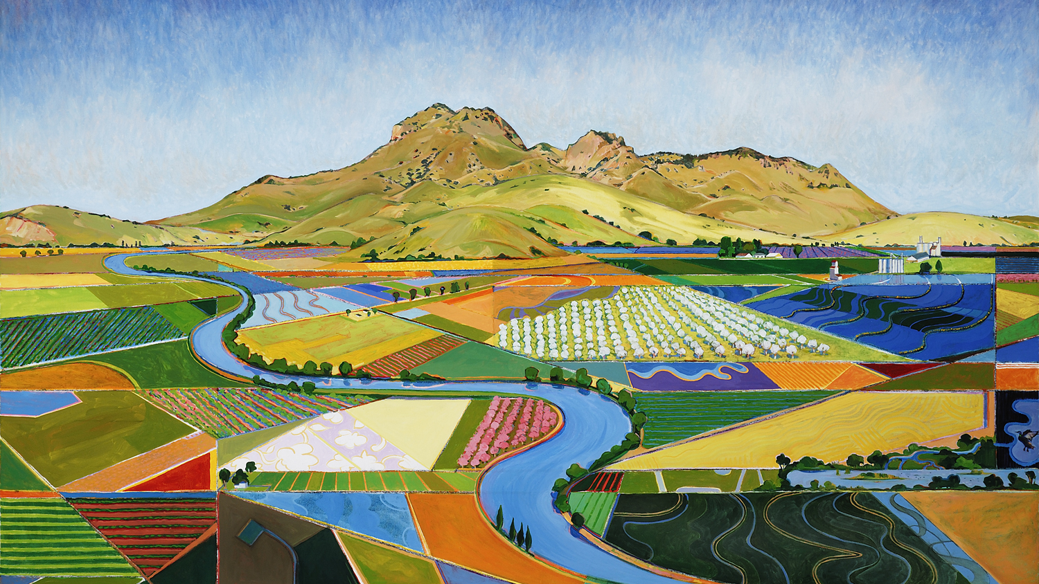
The Sacramento Valley Water Quality Coalition
2024-2025
Sacramento Valley Water Quality Coalition
Fall 2020
Notes:
Hello! Thank you for taking time to watch the 2023-2024 Outreach Presentation for the Sacramento Valley Water Quality Coalition

Slide 2
By watching this video, you will fulfill your annual outreach requirement as a Member of the Sacramento Valley Water Quality Coalition
Notes:
By watching this short video, you will fulfill your annual outreach requirement as a Member of the Coalition.

Slide 3
Overview
Overview of the Coalition
Surface Water Monitoring
Assessment year monitoring.
Pyrethroid pesticides.
Member Requirements
Member reporting – INMP Worksheet and Summary Report, SECP, MPIR.
Member outreach requirement and fees.
Member trainings – INMP and SECP self-certification.
Drinking water well sampling program.
Who Do I Contact for More Information?
Notes:
We will cover a variety of topics today beginning with the history of the Coalition. We will review surface water monitoring results from the past year and take a look at the coming year, which is an assessment year. Then we will move on to talk about member requirements for the coming year so that you have information on how to remain compliant with all regulatory requirements. Throughout the presentation, several links to separate webpages will be mentioned – these links will be clickable in the PowerPoint presentation and available below in the video description.

Slide 4
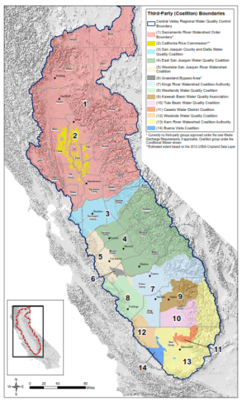
The Irrigated Lands Regulatory Program
Began in 2003 and operates using Waste Discharge Requirements (WDRs) to address potential discharge from agricultural lands.
(Regulated under separate WDRs: Stormwater, food processors, and wastewater treatment plants)
Mandated by the State Water Resources Control Board.
Region 5 is managed by the Central Valley Regional Water Quality Control Board.
If land is commercial and irrigated, it requires coverage under the ILRP.
There are two options:
Join a Coalition
Obtain coverage as an individual grower:
Consists of bearing the full cost and responsibility for compliance, monitoring, and reporting to the Regional Water Board.
Region 5
Notes:
The Irrigated Lands Regulatory Program (ILRP) began in 2003 and operates using Waste Discharge Requirements (WDRs),
which are issued by State and Regional Water Quality Control Boards. The ILRP is simply one of many permits that the
Water Board issues a variety of non-point and point sources. Similar to operations such as storm water, landfills, food
processers, and waste water treatment plants, for nearly a quarter of a century there is and has
been the requirement to understand on irrigated lands may impact surface and groundwater.
Management of the ILRP in the state is divided up into regions – the Sacramento Valley falls into Region 5 which is managed by the Central Valley Regional Water Quality
Control Board, or Regional Board. Within Region 5 there are 14 total agricultural Coalitions and 9 WDRs. Under the ILRP,
all land that is commercial and irrigated requires regulatory coverage by either joining and agricultural Coalition or
obtaining coverage as an individual. Most growers choose to join a Coalition for two main reasons: cost (it’s is less
expensive to complete required surface and groundwater monitoring) and anonymity of farm practices (all member
reports are aggregated and individual reporting data cannot be tied back to individual growers).

Slide 5
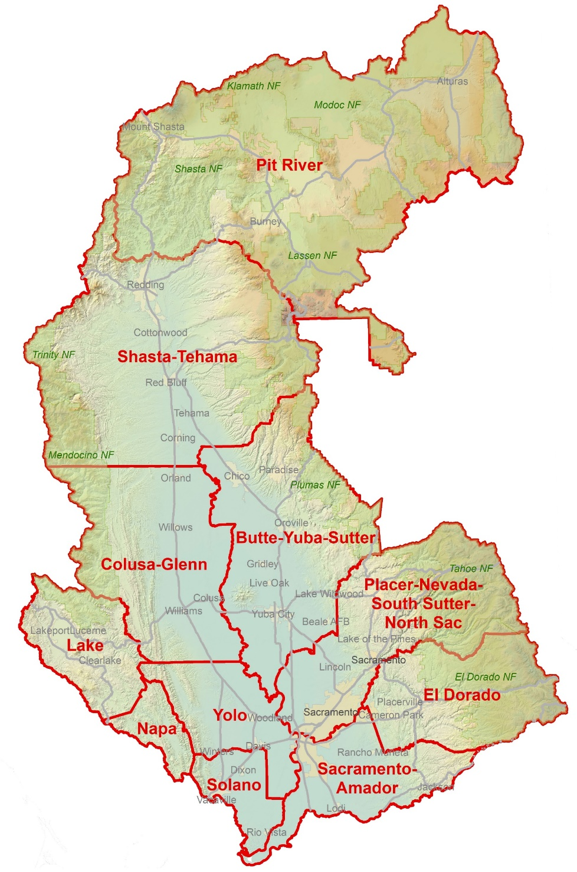
Sacramento Valley Water Quality Coalition
Over 1.17 million irrigated acres.
Over 7,300 Members.
Managed by the Northern California Water Association (NCWA).
Administered by 11 Subwatershed Groups.
Assists with compliance, coordinates surface water and groundwater monitoring, compiles required reports.
Notes:
The Sac-Valley Coalition is the largest agricultural Coalition in the state. It is composed of more than 7,300 landowners
encompassing over 1.17 million irrigated acres and is supported by local farm bureaus, resource conservation districts,
County Agricultural Commissioners, and crop specialists with the University of California Cooperative Extension.
The mission of the Sacramento Valley Water Quality Coalition (Coalition) is to enhance and improve water quality in the Sacramento River Basin, while sustaining the economic viability of agriculture, functional values of managed wetlands, and sources of safe drinking water.
The Coalition is managed by the Northern California Water Association (NCWA) and is administered by 11 local Subwatershed groups. The primary role of the Coalition is to assist landowners in the region with compliance with the WDR through the coordination of surface and groundwater monitoring, compiling required reports, and importantly offering anonymity in the reporting of on-farm practices.
And we are very proud to say that since the submittal of the very first Monitoring and Reporting Program Plan for the Valley in 2004 to the 2019 State Water Board precedential Order which expanded the program to groundwater and initiated the on-farm drinking water well monitoring program to today, the Sac-Valley Coalition and its 11 Subwatershed Groups have successfully maintained regulatory compliance for growers in an equitable and cost effective approach.

Slide 6
State Water Resources Control Board
(Regulatory)
Sacramento Valley Water Quality Coalition/NCWA
(Non-regulatory)
Landowner
Central Valley Regional Water Quality Control Board
(Regulatory)
Notes:
Now, as we just talked about, while the Coalition is heavily involved in helping landowners become and maintain compliance with the Irrigated Lands Program, it is important the mention that the Coalition is NOT the regulatory agency.
The Coalition is an option by which landowners can comply with a State-mandated program. The Coalition only provides information to the Regional Board that is required by the WDR. The State Water Board and Regional Board mandates and manages the program respectively and the Coalition is the go-between for your, the member, and the regulatory agency.
However, the Coalition is the NOT the regulator.

Slide 7
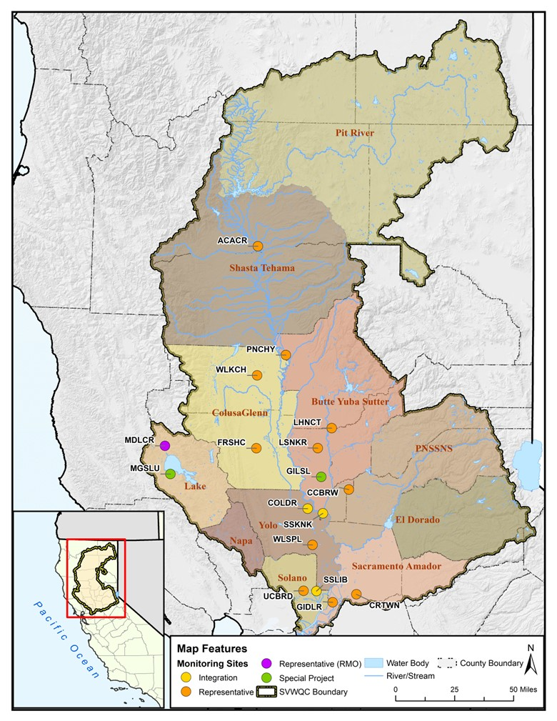
Surface Water Monitoring
3-year cycle of Assessment-Core-Core
During Assessment Year Monitoring, a broader suite of analytes are sampled for and analyzed.
During Core Year Monitoring, only sampling needed for Management Plan implementation and single exceedance follow-up.
2025 is an Assessment Year.
2025 will include 12 monthly sampling events with sites monitored 10 to 11 times during the year.
Includes sampling for: physical/general chemistry (turbidity, TDS, TOC, DOC, etc.), pathogens, nutrients, metals (copper), registered pesticides (inc. pyrethroids), toxicity in water column and sediment.
No Core monitoring in RMO Subwatersheds
*Monitoring Years take place from October - September
Notes:
One of the primary ways the Coalition fulfills its obligations under the WDR is through surface water monitoring. At one point, while the ILRP was being developed, the Regional Board was considering edge-of-field monitoring. Essentially, each landowner could have been required to sample any discharge leaving their fields to ensure it met regulatory limits. Instead, Coalition members are allowed to operate using representative monitoring sites instead at which water and sediment samples are taken to represent the entire drainage area.
The Coalition collects water quality and sediment samples on a 3-year cycle of Assessment-Core-Core. The 2025 monitoring year, which began October 1, 2024 and will end September 30, 2025, is an Assessment Year so a broader suite of analytes will be sampled for and analyzed. 12 monthly sampling events will take place across the 11 Subwatersheds with all sites monitored 10 to 11 times during the year. Things like physical and general chemistry, pathogens, nutrients, metals, registered pesticides (including pyrethroids), and toxicity in the water column and sediment will be analyzed. No monitoring will take place in Subwatersheds operating under the Reduced Monitoring Option, which are NECWA, El Dorado, Napa, with the exception of Lake County which requires some monitoring under the Nutrient TMDL.

Slide 8
2024 Monitoring Year (October – September)
Management plans completed = 0
Management plans triggered = 1
Regional Water Board told Coalition that a Management Plan for Nitrate + Nitrite is required in Grand Island Drain
SVWQC Monitoring Year 2024 Results: Oct 2023 - Sep 2024
Analyte | # of Analyses¹ | # of Exceedances | # of Exceedances | % Exceedances | % Exceedances
Trace Metals | 15 | 1 | 0 | 1.5% | 0.0%
Nutrients | 70 | 4 | 0 | 1.0% | 0.0%
Registered Pesticides (Non-pyrethroids) | 52 | 0 | 0 | 0.0% | 0.0%
Ceriodaphnia and Selenastrum Toxicity | 23 | 1 | 0 | 0.9% | 0.0%
Pyrethroids² | 22 | 8 | 9 | 13.6% | 40.9%
Hyalella azteca Toxicity - WC | 16 | 0 | 1 | 0.0% | 0.9%
Hyalella azteca Toxicity - Sed | 10 | 9 | 0 | 37.5% | 0.0%
[1] = Includes field duplicate analyses [2] = Pyrethroid exceedance considers measured concentrations of six TMDL pyrethroids (bifenthrin, cyfluthrin, cypermethrin, esfenvalerate, lambda-cyhalothrin, permethrin)
WC = water column, Sed = sediment
Notes:
The previous monitoring year, the 2024 Monitoring Year, was a Core Year. Unfortunately, no existing Management Plans were completed and one new Management Plan was triggered. In the last year’s presentation, we reported that the Coalition had successfully avoided a Management Plan in the Sacramento-Amador Subwatershed for Nitrate + Nitrite as Nitrogen because it was found the triggering exceedance was caused by an unenrolled grower. Unfortunately, after many discussions and despite our strong disagreement with the decision, the Regional Board notified the Coalition in July 2024 that we would need to develop a Management Plan after all. A Management Plan in the Colusa Glenn Subwatershed was also triggered for pyrethroids.
Directing your attention to the table, which shows an overview of monitoring results from the past year, you can see that only exceedances of pyrethroids and hyallela toxicity in the water column were observed. Pyrethroids continue to be detected and exceed limits over 40% of the time.

Slide 9
SVWQC Pyrethroid Monitoring: Jan 2018 - September 2024
Subwatershed | SiteID | # Exc | # Analyses* | Exc Rate
BYS | LHNCT | 5 | 31 | 16.1%
 | LSNKR | 12 | 30 | 40.0%
 | PNCHY | 18 | 33 | 54.5%
 | SSKNK | 0 | 17 | 0.0%
Colusa Glenn | COLDR | 2 | 20 | 10.0%
 | FRSHC | 6 | 26 | 23.1%
 | WLKCH | 2 | 12 | 16.7%
El Dorado | NRTCN | 0 | 3 | 0.0%
Lake | MDLCR | 0 | 1 | 0.0%
NECWA | PRPIT | 0 | 11 | 0.0%
PNSSNS | CCBRW | 2 | 26 | 7.7%
Sac Amador | CRTWN | 1 | 15 | 6.7%
 | GIDLR | 0 | 23 | 0.0%
Shasta Tehama | ACACR | 1 | 20 | 5.0%
Solano | SSLIB | 0 | 17 | 0.0%
 | UCBRD | 3 | 28 | 10.7%
Yolo | WLSPL | 1 | 16 | 6.3%
1. Cypermethrin
Mustang
2. Lambda-Cyhalothrin
Warrior, Lambda-Cy
3. Bifenthrin
Brigade, Bifenture, Capture, Fanfare
4. Esfenvalterate
Du Pont Asana
5. Permethrin
Permastar
6. Cyfluthrin
Tombstone
Integration Site
*Analysis of pyrethroids was performed because PUR data show that pyrethroids
are applied in a particular drainage during a particular month
Notes:
The 2024 Monitoring Year brings overall exceedance rates for pyrethroids evaluated from January 2018 to September 2024 to levels greater than 10% in most Valley Floor Subwatersheds. Exceedances at the Pine Creek site in the Butte-Yuba-Sutter Subwatershed are at 54.5%. The 6 pyrethroid pesticides that are monitored for can be seen on the right – they are cypermethrin, lamba-cyhalothrin, bifenthrin, Esfenvalerate, permethrin, and cyfluthrin.

Slide 10
Monitoring for Pyrethroid Pesticides
Pyrethroids are highly toxic at low concentrations to invertebrates eaten by waterfowl and fish.
Chronic and Acute ILRP Trigger Limits
Chronic – Chronically toxic to test organisms.
Acute – Acutely toxic to test organism.
Bifenthrin > Lamba-Cyhalothrin > Cypermethrin > Cyfluthrin > Esfenvalerate > Permethrin
Pyrethroids bind tightly to organic matter and soil particles.
Stewardship approach and Best Management Practices (BMPs) reduce potential for drift or runoff of pyrethroid pesticides.
Resources:
Pyrethroid Insecticides for Row Crops – Coalition for Urban and Development
Pyrethroid Insecticides for Orchard Crops - Coalition for Urban and Development
Orchard Sprayer Calibration - Coalition for Urban and Development
Pyrethroid Focused Outreach Meeting Video – Effective Orchard Spraying by Franz Niederholzer, UCCE
Notes:
I know that we must sound like a broken record when it comes to pyrethroid pesticides, but unfortunately since we continue to see exceedances we must continue to provide outreach and resources. So, Pyrethroids are highly toxic at low concentrations to invertebrates eaten by waterfowl and fish. ILRP trigger limits are VERY LOW. Pyrethroids have both chronic and acute ILRP trigger limits that are compared to the same unitless value of 1. In terms of toxicity, some pyrethroids are more toxic than others, with bifenthrin being the most toxic and permethrin being the least toxic. But despite this toxicity rating, growers should be extremely cautious when applying any pyrethroid pesticide.
Pyrethroids bind tightly to organic matter and soil particles. So, among other BMPs, growers should pay special attention to reducing drift and sediment run-off. A stewardship approach is the best approach. For more information on pyrethroids and BMPs, please refer to the resource links at the bottom. They can also be found in the video description.

Slide 11
Six Active Management Plans in the Coalition
Management Plan = 2 or more exceedances of the same constituent at the same site within a 3-year period.
Completed through a combination of monitoring results and management practice documentation.
Minimum of 3-years without any additional exceedances.
Subwatershed | Site | Analyte | Trigger Date | Earliest Completion Date
Solano | Ulatis Creek at Brown Rd. | Hyalella Toxicity and Pyrethroids | 4/18/2019 | 8/1/2025
BYS | Lower Snake River at Nuestro Rd. | Pyrethroids | 7/22/2021 | 3 years from most recent exceedance
BYS | Pine Creek at Hwy 32 | Pyrethroids | 8/19/2021 | 3 years from most recent exceedance
BYS | Lower Honcut Creek at Hwy 70 | Pyrethroids | 1/18/2022 | 3 years from most recent exceedance
Sacramento-Amador | Grand Island Drain at Leary Rd. | Nitrate + Nitrite as Nitrogen | 12/28/21* | Spring 2027
Colusa Glenn | Freshwater Creek at Gibson Rd. | Pyrethroids | 7/25/2024 | Fall 2027
*Coalition not notified that Management Plan required until July 2024
Notes:
As of October 2024, the Coalition has five Management Plans for and related to pyrethroid pesticides – four in BYS and one in Colusa-Glenn. As a reminder, a Management Plan is triggered when there are 2 or more exceedances of the same constituent at the same site are observed within a 3-year period and they can only be completed through a combination of monitoring results and management practice documentation after a minimum of 3-years have passed without any additional exceedances. This means, each time another exceedance is observed the management plan is pushed out another 3 years at least. In addition to the pyrethroid related Management Plans, the Coalition has the Management Plan for nitrate + nitrite as nitrogen in the Sacramento -Amador Subwatershed which we discussed earlier.
What do these Management Plans mean practically to you as a member? Well, each management plan triggers the requirement for more surface water monitoring and more member reporting which in turn triggers increased consultant and staff time all equating to increased costs.

Slide 12
Looking Ahead to the 2025 Monitoring Year
REMEMBER!
BMPs for Pesticides
Adopt on-site practices to reduce run-off.
Follow proper mixing and loading practices.
Properly calibrate sprayer.
Carefully select mixing and loading site.
Sprayer set up and good application techniques.
Monitor all weather conditions prior to, during, and after an application.
The best way to keep costs down in to avoid triggering exceedances and Management Plans.
Exercise
EXTREME CAUTION
when applying all pesticides,
especially pyrethroids.
Notes:
So looking ahead to the rest of the 2025 monitoring year, which did already begin on October 1 here are the main things we would like members to take away: the best way to keep costs down is to avoid triggering exceedances and management plans and to complete existing management plans as soon as possible. To do that, please always exercise extreme caution when applying all pesticides, but especially pyrethroids.

Slide 13
Coalition Member Requirements
Last updated Fall 2024
Notes:
We are going to move on to speak about requirements that Coalition members should keep in mind in the coming year.

Slide 14
Notes:
Member requirements are quite similar to requirements in previous years.
The Irrigation and Nitrogen Management Worksheet, which must be completed each year by March 1. The worksheet stays on farm and is not turned in to the Coalition. . If your property is in an area that is high vulnerability for nitrogen or you have a field identified as an“outlier”, you will be required to certify your worksheet. We will talk about certification options in a few minutes. Now although it is not necessarily being tracked at the Coalition level, if your property is selected for on On-Farm Inspection by the Regional Board, you will be required to produce this document for at least the 3-5 previous crop years
The Irrigation and Nitrogen Management Summary Report DOES need to be turned in to the Coalition. Some Subwatersheds have an online tool to complete this report. In this report, you report your actuals from the previous crop year – including actual nitrogen applied and yields. For 2024 reporting, you will report for the 2023 crop year.
Members in the Valley Floor are also required to complete a groundwater quality Management Practice Implementation Report, or MPIR, which is also available to be completed online. And members in a drainage with an active surface water quality Management Plan are required to complete a surface water MPIR.
Areas identified as high vulnerability for sediment erosion, a Sediment Erosion Control Plan must be completed and certified ONCE. And again, we will discuss options for certification of the SECP in a few minutes.
And of course there is the annual outreach participation, which you are completing by watching this vide.
I would like to emphasize that because you are a Member of the Coalition, nitrogen use, yields, and other on-farm practices collected through these reports remain anonymous, and cannot be traced back to a specific grower.
We here at the Coalition are here to help you keep track of what is required to be completed when. We will notify you of everything that is needed for compliance. BUT, please remember that the ultimate responsibility for completing all requirements is up to each individual grower.
Information collected though these reports have been instrumental in streamlining some ILRP requirements and demonstrating that drinking water limits are already being met in the groundwater based. This has been done through calculation of groundwater protection values at the township scale. The information is also basis for continued right-sizing of the program in the Sacramento Valley that began in 2009 with the Reduced Monitoring Management Practices Alternative for upper watershed agricultural areas.

Slide 15
Consequences for Failure to Complete Annual Reporting ON TIME
Late Reporters
INMP Summary Report and GW/SW MPIR due to the Coalition by March 1 annually as required by the WDR.
Failure to complete the reports will result in enforcement from the Regional Board and potential fines up to $1,000 per day from the time the report was due (March 1 annually).
ACL
Pre-ACL or Compressed ACL
Last Chance Phone Call
Drive-by Inspection
Notice of Violation
Reminder Letter
Severity
To avoid enforcement and late penalties, complete reporting ON TIME and respond to enforcement letters IMMEDIATELY.
Outreach/Reminders from the Coalition
Notes:
Members who fail to complete their reporting ON TIME, will have their names submitted to the Regional Board, as required by the WDR. At this point, the Regional Board, as the regulatory agency, will follow-up with members to get those late reports in the form of phone calls and letters. The Coalition will continue to assist members in completing the reports, even after the deadline passes, however, it should be mentioned that their may be late fees to account for the additional staff time required to help with late reports.
The Regional Board performs what is called progressive enforcement. Displayed here is the enforcement pyramid used for late reporters. Between each level is a waiting period, in which Members are given an opportunity to respond. If a Member does not respond, they move up to the next level of enforcement. Now the goal of these efforts is not to frighten landowners or collect fines, but it is to get landowners compliant and receive the data. That being said, there are consequences if a member fails to respond and submit the late, including fines up to $1000 per day. Similar processes are used for members who fail to pay their dues and non-enrolled land owners.
If you are ever a recipient of one of these types of letters, PLEASE REPOND IMMEDIATELY to avoid being escalated to the next level. However, if you are a member the best way to avoid enforcement from the Regional Board is to complete your reporting on time and pay your dues.

Slide 16
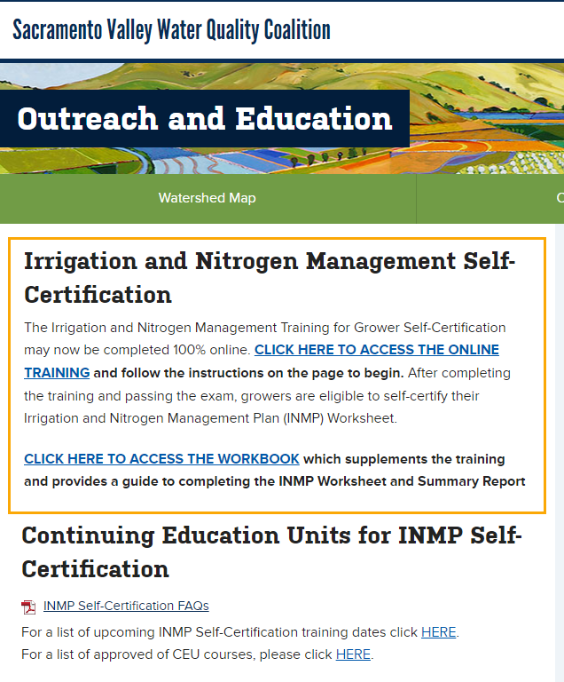
Grower Self-Certification Trainings
INMP Self-Certification Training
Members who have fields in high vulnerability areas for nitrogen or have been identified as outliers are required to certify their INMP Worksheet.
Self-certification is one option.
After completing the training and passing the online exam, growers are eligible to self-certify their INMP Worksheet.
SECP Self-Certification Training
AVAILABLE FROM FEBRUARY 1, 2025, to FEBRUARY 28, 2025
Members who have fields in high vulnerability areas for sediment erosion as identified in the SDEAR.
Self-certification is one option.
After completing the training and passing the online exam, growers are eligible to self-certify their SECP.
Visit www.svwqc.org/outreach-and-education/ to access trainings
Notes:
As you recall, the INMP Worksheet and SECP require certification, if you are in an area determined to be high risk for nitrogen or sediment erosion. One option to certify these reports is to become self-certified.
The INMP Grower Self-Certification Class is available online at any time. After taking the course and passing an open-book online exam, growers are eligible to self-certify their INMP Worksheet. If you use a CCA, they may also certify your Worksheet as long as they have completed the CCA nitrogen certification course.
The SECP Self-Certification Training will be available during the month of February. This training also requires passing an open-book online exam.
To access the trainings, please visit the link on the page. If you would like to certify your reports in a different way, please reach out to your Subwatershed for options

Slide 17
Annual Fees and Dues
Membership fees and per acre fees determined by each individual Subwatershed.
Based on a variety of factors… size of membership, number of monitoring sites, existence of management plans, etc.
Fees cover :
State Water Quality Fee for 2024-2025 ($1.21 per irrigated acre for irrigated pasture with no external nitrogen inputs and $1.49 for all other crops).
Programmatic costs (including Assessment Year surface water monitoring).
Local costs (membership support for invoicing/reporting and administration by local Farm Bureaus, RCDs, etc.).
Notes:
To remain a Member in good standing, you must also pay you annual fees and dues ON TIME, or risk being dropped. Fees are determined by each Subwatershed and depend on factors such as size, number of monitoring sites, and existence of Management Plans.
The fees also cover the State Water Quality Oversight Fee – which for 2024 will be $1.21 per irrigated acre for irrigated pasture with no external nitrogen inputs and $1.49 per irrigated acre for all other crops. Fees also programmatic costs such as surface water monitoring and local costs such as membership support.

Slide 18
On-Farm Active Drinking Water Well Monitoring Program
Annual sampling event must take place before January 1 each year
Applies to ENROLLED parcels with wells ACTIVELY used for drinking or cooking.
Must sample for nitrate + nitrite as nitrogen.
Must use an ELAP Certified Lab (list can be found at https://www.waterboard.s.ca.gov/drinking_ water/certlic/labs/).
Sampling Requirements:
Sample annually until your results meet one of the following:
Less than 8 mg/L submitted for three consecutive years – sampling frequency reduced to once every five years.
Greater than 10 mg/L – no further sampling required. Must fulfill the notification requirement.
Between 8-10 mg/L – continue to sample annually.
If you have questions,
Contact The Central Valley Regional Water Quality Control Board, ILRP
Phone: (916) 464-4611 | Email: irrlands@waterboards.ca.gov
Or visit > https://www.waterboards.ca.gov/centralvalley/water_issues/irrigated_lands/drinking_water/
Notes:
2025 will be Year 4 of the On-Farm Drinking Water Well Monitoring Program in the Sacramento Valley. This requirement is mandated by the State Water Board for the entire Central Valley. Under this requirement, members must sample all wells on
enrolled that are actively used for drinking or cooking for nitrate + nitrite as nitrogen. An ELAP certified lab must be used for analysis. You must sample annually before January 1 until your results meet one of the following:
Less than 8 mg/L submitted for three consecutive years – sampling frequency reduced to once every five years
Greater than 10 mg/L – no further sampling required. Must fulfill the notification requirement.
Between 8-10 mg/L – continue to sample annually
For questions regarding this requirement, please contact the Regional Board with the contact information in yellow.

Slide 19
State Water Resources Control Board
(Regulatory)
Sacramento Valley Water Quality Coalition/NCWA
(Non-regulatory)
Landowner
Central Valley Regional Water Quality Control Board
(Regulatory)
Notes:
And as we wrap up this presentation, I would like to emphasize once again that the Coalition is not the regulatory agency. We are one option to help you comply with the State-mandated irrigated lands regulatory program.

Slide 20
For More Information…
Contact Your Subwatershed Representatives – click here
SVWQC Website – click here
Central Valley Regional Water Quality Control Board Website – click here
Waste Discharge Requirements General Order for Growers within the Sacramento River Watershed that are Members of a Third-Party Group – click here
Irrigated Lands Regulatory Program – Drinking Water Well Monitoring – click here
Bruce Houdesheldt – Director of Water Quality, NCWA
bruceh@norcalwater.org
916-442-8333
455 Capitol Mall Suite 703, Sacramento, CA, 95814

Slide 21
The Sacramento Valley Water Quality Coalition
T H A N K
Y O U
Fall 2020

