Slide 1



Irrigation and Nitrogen Management Training
January 2020
for Grower Irrigation and Nitrogen Management Plan Self-Certification

Slide 2
Irrigation and Nitrogen Management Training for Grower INMP Self-Certification
Original Presentation Developed By:
University Of California, Davis
  Patrick Brown
  Daniel Geisseler
  Allan Fulton
  Tim Hartz
  Stuart Pettygrove
  Terry Prichard
  Larry Schwankl
  Carol Frate
  Marsha Campbell Mathews
  Gabriele Ludwig, Almond Board of CA
  Asif Maan, CASS
  Rob Mikkelsen, IPNI
  Jerome Pier, Crop Production Services
  Sebastian Saa, Almond Board of CA

Slide 3
Table of Contents
Introduction
Sections
1: Overview of nitrogen and groundwater quality issues
2: Nitrogen in crop production systems
3: Nitrogen fertilizers and management
4: Efficient irrigation management
5: Efficient nitrogen management
6: Irrigation and Nitrogen Management Plan and Summary
Report
7: Resources

Slide 4
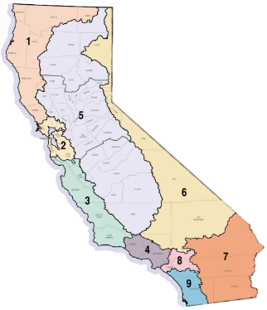
Irrigated Lands Regulatory Program (ILRP)
Managed by the Regional Water Quality Control Board
Applies to all growers who irrigate commercial crops
Board uses Waste Discharge Requirements (WDR) to specify what growers and coalitions must implement to protect groundwater and surface water.
Notes:
Note: The dairy order to control nitrate groundwater pollution by confined animal feeding operations is also a part of the Central Valley Water Board program, but is not a part of this course.

Slide 5
Regulations: Waste Discharge Requirements
  Growers with irrigated lands must either join regional coalitions or meet WDR requirements individually.
Coalition Tasks in the Central Valley:
  Groundwater quality assessments and plans
  Monitoring long term groundwater quality trends
  Assess which BMPs protect groundwater quality
  Surface water quality monitoring
  Compilation of data submitted by growers and reports to Regional Water Board
Notes:
Note: Tasks carried out by the coalitions will be funded by the per acre assessment fees collected. The coalitions will also manage the certified nutrient management plans. After they compile data, average performances will be reported regionally.
For a grower, preparing to meet WDR requirements individually is riskier and more burdensome than joining a regional coalition.

Slide 6
Regulations: Waste Discharge Requirements
Growers are responsible for:
  Attending one outreach event (yearly)
  Farm Evaluation Survey (5 years)
    (kept on farm)
  Sediment and Erosion Management Plans
    Where needed (kept on farm)
  Irrigation and Nitrogen Management Plans
    Yearly (kept on farm)
  Irrigation and Nitrogen Management Plan Summary Report
    Yearly (submitted to Coalition)

Slide 7
Certifying Irrigation and Nitrogen Management Plans
Options for certification:
  Certified Crop Adviser with Nitrogen Management Training
  Certified Professional Soil Scientist
  Certified Professional Agronomist
  Technical Service Providers
  Certified Agricultural Irrigation Management Specialists
  Grower Self-Certification (owned or managed fields only)
Notes:
Notification of vulnerability status is indicated on the form packet sent to grower members each year or is available on the Member Portal available on the coalition’s website.

Slide 8
Grower Self-Certification Requirements
Nitrogen Management Plan Certification Training
  4 hours
  Passing grade (70%) on test*
Certification Period
  3 years
Re-certification
  Continuing education required
    3 hours in 3-year time period beginning January 1
  * Test can be taken multiple times
Notes:
Irrigation and Nitrogen management training and passing test constitutes certification
The time frame for re-certification is 3 years beginning Jan 1 of the calendar year the exam was taken. Growers that took the course in or before 2018 have until January 1, 2021 to complete their 3 CEUs.

Slide 9
Irrigation and Nitrogen Management Plan Certification Training
Project administered by the Coalition for Urban Rural Environmental Stewardship (CURES)
Certification presentations are by Certified Crop Advisors (CCA) who have completed the UC/CDFA Nitrogen Management Program as a trainer
Coalitions facilitate the training meetings
Notes:
FREP Fertilizer Research and Education Program a division of the California Dept. of Food and Ag (CDFA)

Slide 10
Irrigation and Nitrogen Management Plan Certification Training
Regulatory Oversight of Grower Trainings
  Water Board has approved this INMP training approach
  CDFA and the Coalitions will audit presentations at grower trainings to ensure professionalism by CCAs

Slide 11
Irrigation and Nitrogen Management Plan Certification Training
Provide information for
  Efficient use of nitrogen fertilizers
  Minimize environmental impacts
  Meet Regulatory compliance requirements
    Irrigation and Nitrogen Management Plan
    Irrigation and Nitrogen Management Summary Report

Slide 12
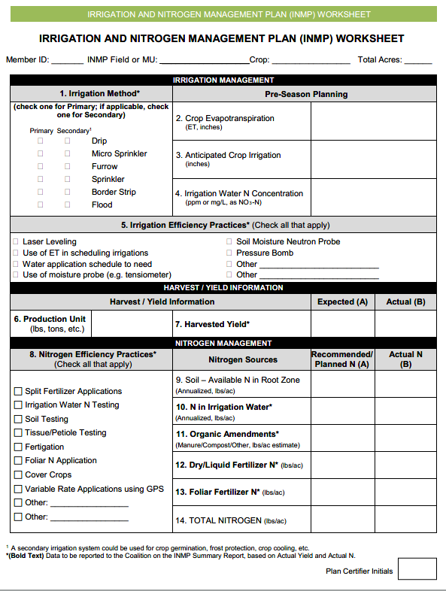
Notes:
The plan prepared prior to the crop season you keep on farm

Slide 13
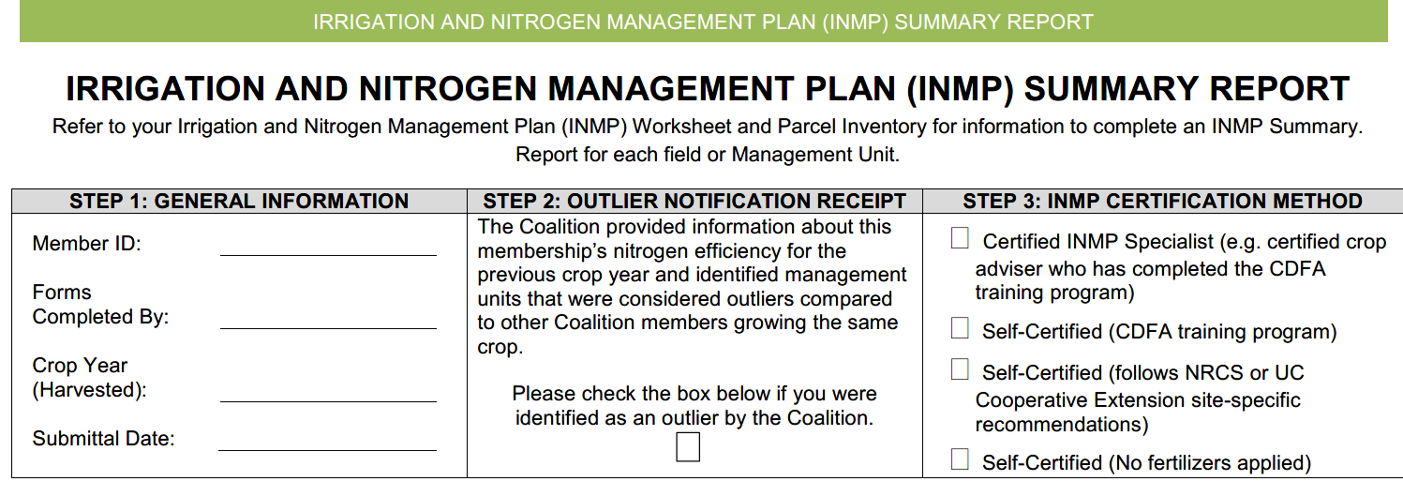
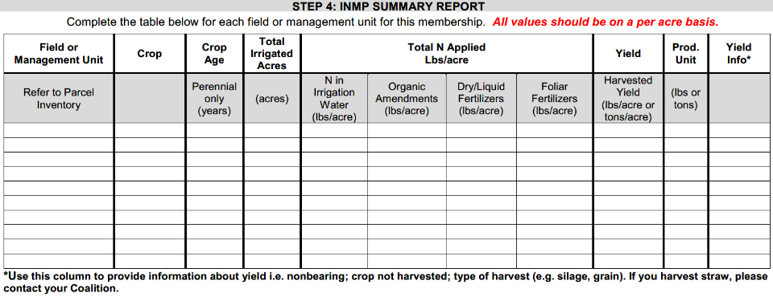

Slide 14
Overview of Nitrogen and Groundwater Quality Issues
Section 1

Slide 15
Section 1 Learning Objectives
Recognize how nitrate became a problem
Recall areas that are more vulnerable to nitrate contamination.
List the sources of nitrogen.
Distinguish between the different ways to measure nitrate in the groundwater.

Slide 16
How Did Nitrate Become a Problem?
In nature, nitrogen (N) cycles through soil, water, and plants at low concentrations (approx. 2ppm).
Agriculture requires high N input to produce profitable crops which increases soil N concentrations.
Inefficiency of irrigation and N applications leads to nitrate leaching losses.
Notes:
Note: The natural background concentration of nitrogen cycling though soil, water, and plants is about 2 ppm (2mg/L).

Slide 17
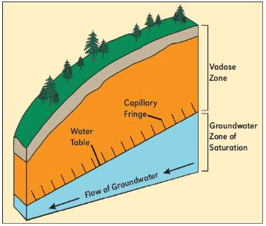
Why is Shallow Groundwater Most Affected?
Nitrate (N0₃⁻) is an anion (negatively charged) and is not retained by the soil. It moves with water.
Water moving below the root zone can carry nitrate with it.
After years of downward flow with water, nitrate eventually reaches the aquifer.
The closer the groundwater is to the source, the sooner nitrate will reach the groundwater.
Notes:
Ground water may become polluted more quickly where soils are layered (eg. alluvial soils) and exhibit preferential flow that can shorten the time it takes for nitrate to reach the groundwater.
Figure: Arrows show different distances to water table

Slide 18
Nitrate. What is the Problem?
Nitrate in Drinking Water
  Federal/CA Maximum Contaminant Level (MCL) is 10 ppm Nitrate expressed as NO₃–N
    MCL was determined by US EPA, “to prevent methemoglobinemia in infants”
  Concentrations in drinking water of some CA aquifers exceed this level.
    CA State Water Resources Control Board noted that 8% of drinking water wells exceed the nitrate threshold.

Slide 19
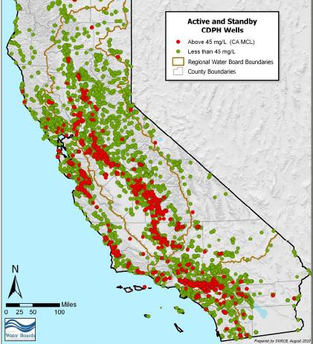
Active and Standby Wells
Above 10 mg/L or
ppm NO₃-N (MCL)
Nitrate Problem
Areas in California
Areas with shallow
groundwater and
intensive agriculture
are vulnerable to
nitrate contamination
Above MCL
Below MCL
(Maximum Contaminant Level)
Notes:
Figure: From the State Water Resources Control Board, this image shows red dots as active and standby California Department of Public Health (CDPH) wells that are in excess of the 10 ppm N0₃-N MCL as of June 2010.
The main areas of concern are the Coast, the Delta, the Tulare Lake Bottom and the East Side of the San Joaquin Valley. All these areas have shallow depth to ground water combined with intensive agriculture.

Slide 20
Where is nitrogen coming from in California?
Data from Salinas Valley and Tulare Lake Basin
Notes:
Figure: This information is from “Addressing Nitrate in California’s Drinking Water,” linked below. The researchers determined the sources and fates of cropland-applied nitrogen in the Salinas Valley and Tulare Lake Basin. They accounted for all the sources of nitrogen inputs applied in one year in the study areas. More than half of the inputs by mass are from synthetic fertilizer, plus a third from dairy manure, accounting for 86% of total nitrogen inputs.
Addressing Nitrate in California’s Drinking Water: http://groundwaternitrate.ucdavis.edu/files/138956.pdf
Please note these data are from Salinas and Tulare Lake Basin and are not necessarily representative of all California.

Slide 21
Of the total N inputs where is nitrogen going in California?
Data from Salinas Valley and Tulare Lake Basin
Notes:
Figure: In a mass balance model, the mass of the inputs must equal the mass of the outputs. By estimating the amount of total nitrogen exported in the harvested portion of the crop as well as nitrogen lost to the atmosphere by denitrification, volatilization, and surface runoff, the remaining nitrogen is assumed to have leached below the crop root zone. In these cases, 51% of nitrogen was available to leach to groundwater.
Please note theses data are from Salinas and Tulare Lake Basin and are not necessarily representative of all California.

Slide 22
Dealing with Nitrate Pollution
No inexpensive method exists to remove nitrate once it is in water
Source control: Accounting for all the sources of nitrogen in the system leads to more efficient use of nitrogen and fertilizer products.
    Sources of nitrogen:
      Mineralization of organic nitrogen
      Residual soil nitrogen
      Nitrogen in irrigation water
      Nitrogen fertilizers
Notes:
Eliminating nitrates from drinking water is expensive and cannot be done with charcoal filters. Only by ion exchange, reverse osmosis or electrolysis, can nitrate be removed from water.
Accounting for all the sources of nitrogen in the system - including mineralization, residual nitrogen and nitrogen in irrigation water – leads to more efficient use of nitrogen and fertilizer products. This saves the grower money and improves conditions in affected communities.

Slide 23
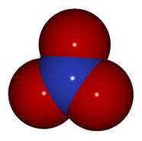

Measuring Nitrate Concentrations
Preferred Unit
Maximum contaminant levels
Measuring Nitrate-N:
10 ppm NO₃⁻-N
(measures only the N
in the Nitrate)
Measuring Nitrate:
45 ppm NO₃
(measures N + O₃)
=
O
N
N
O
O
Notes:
Most Labs report Nitrate concentration as NO₃—N. This is the preferred units since well testing will require NO₃—N concentration reporting
When Nitrate concentration is measured in nitrate-N (NO₃--N), only the nitrogen is measured. 10 ppm MCL
When Nitrate concentration is measured in nitrate (NO₃), nitrogen and oxygen are both measured. 45 ppm MCL
The two maximum contaminant levels are the same– only difference is the mg/L is the weight on N + O₃ versus N only .
A factor of about 4.5
62.0049 / 14.0067 = 4.427

Slide 24
Nitrogen in Crop Production Systems
Section 2

Slide 25
Section 2 Learning Objectives
Identify the parts of the nitrogen cycle and recognize conditions that favor each process
  Mineralization
  Nitrification
  Plant uptake
  Microbe uptake (Immobilization)
  Volatilization
  Denitrification
  Leaching

Slide 26
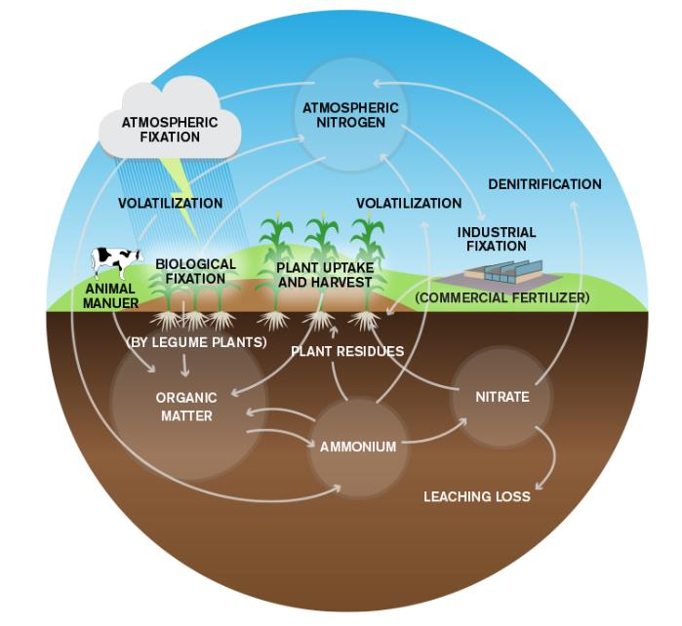
Overview of the nitrogen cycle
Notes:
This photo shows the complexity of the N cycle the basic cycle is from the major pools of N.
The atmosphere is the largest pool (N2) at 78% with the soil organic matter (organic N) the next largest.
1% OM in acft soil is about 40,000 lbs. At a stable C:N ration of 10:1, that 1 ft slice would contain 4,000 of N
Both pools are not available for non-legumeous plants.
The N must be transformed into usable mineral N for plant and microbe use.

Slide 27

Mineralization
A microbial process that converts organic N to plant available inorganic N in the form of ammonium (NH₄⁺)
Soil Organic Matter
Mineralization
NH₄⁺
Ammonium
Notes:
Mineralization of organic matter to ammonium through microbe decomposition
The process occurs when organic materials, such as soil organic matter, manure, plant residue, or biosolids, are decomposed by soil microorganisms.
Mineralization refers specifically to those decomposition processes that release inorganic compounds (N) from organic matter

Slide 28
Soil Organic Matter
Soil organic matter consists of fresh residues, partially decomposed organic materials, and humus
Soil organic matter stores soil carbon and nutrients in the soil
The process of N release from soil organic matter is driven by microbes
  Carbon and nutrients are taken up as microbes grow then they are released as mineral N upon death (mineralization).
Notes:
SOM stores soil carbon and nutrients
Carbon acts as a food source for microbial populations
N is alternately taken up as microbes grow and released as they die
The majority of soil organic matter is recalcitrant and does not interact with N. It is the small fraction of organic matter that is soluble that can interact with N and is hence most important.
The process of N release is driven by microbe populations
Release carbon and nutrients for their growth
Mineral N is produced

Slide 29
Mineralization
Organic N to Mineral N
Carbon-to-Nitrogen ratio (C:N) of organic materials is one of the main factors controlling mineralization rates.
Environmental conditions such as , tillage (aeration), temperature, and moisture enhance mineralization rates.
Notes:
Mineralization is a particularly relevant component of the N cycle when a grower has or adds large amounts of SOM.
Net mineralization = gross mineralization – immobilization
If immobilization is high little N is available for plant uptake

Slide 30
Nitrification
A microbial process that converts ammonium (NH₄⁺) to nitrate ( NO₃⁻)
Fertilizers
Soil Organic Matter
NH₄⁺
Ammonium
Nitrification
NO₃⁻
Nitrate
Notes:
This is the most relevant component of the soil N cycle for California agriculture
Nitrification is the biochemical oxidation of ammonium to nitrate that occurs in warm, moist, well aerated soils
Nitrosomonas is a heterotrophic bacterium that converts ammonium to nitrite.
Nitrobacter is an autotrophic bacterium that oxidizes nitrite to nitrate. The final product is nitrate, which is readily available for plant uptake.

Slide 31
Nitrification
Ammonium → Nitrate
Ammonium is used as an energy source by bacteria resulting in the production of nitrate
  Nitrate is readily available for plant uptake
Process enhanced by warm, moist, and well aerated soils

Slide 32
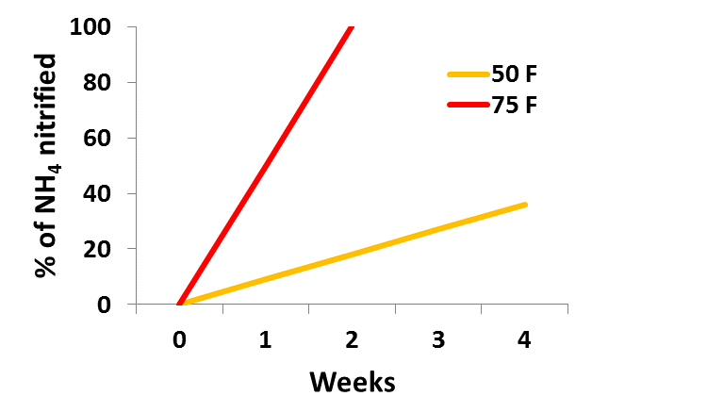
Nitrification: How Quickly Does it Occur?
Average May-Sept Soil Temp SJV 0-4 inches
Average of 50%
In 1-2 weeks
(Figure: Adapted from Western Fertilizer Handbook)
Notes:
Figure: Estimate of nitrification rates in California soils (San Joaquin and Salinas Valleys), depending on soil temperature.
Mention average of 50% in 1-2 weeks

Slide 33

Ammonia Volatilization
Volatilization is the loss of gaseous ammonia to the atmosphere
Fertilizers
Soil Organic Matter
NH₃
Ammonia
Ammonium
NH₄⁺
Volatilization
Nitrate
NO₃⁻
Notes:
Ammonium produced by mineralization or added directly to the soil has one of several fates, including binding directly to soil at cation exchange sites (CEC), mixing into soil water or being lost to volatilization or escape out the soil pores to the atmosphere
Additionally, vermiculite clays expand when wet and contract when they dry trapping NH₄⁺ ions between the clay plates.
The release back to the soil solution is very slow.
Note: In the liquid phase of the soil (the soil solution), or in irrigation water, there is an equilibrium between NH₄⁺ (which is not volatile) and NH₃ (which is volatile); the NH₃ can diffuse out of the solution and soil pores and be released to the atmosphere

Slide 34
Ammonia Volatilization
The loss of gaseous ammonia (NH3) to the atmosphere
Materials where ammonia gas is present or is a result of their breakdown include fresh manure, ammonia injections, urea, and UAN
Conditions that favor volatilization
  Lack of soil incorporation
  Dry soil (low moisture content)
  Coarse-textured soils (sandy)
  High pH soils/water
Notes:
Ammonia gas (NH₃) can be present in fresh manures and anhydrous ammonia injections, and is also a breakdown product of urea and UAN. In gas form, it is easily lost to volatilization. Typically, soil moisture is adequate to rapidly convert NH₃ (ammonia), to NH₄⁺ (ammonium), preventing volatilization. However, in dry soil, especially when coarse-textured and high pH, NH₃ volatilization can be significant (up to 30%).

Slide 35

Nitrogen Cycle –Nitrate Losses
N₂
N₂O
Nitrous Oxide gas
Nitrogen gas
NO
Nitric Oxide gas
NO₃⁻
Denitrification
Leaching
Notes:
This is the most difficult component of the cycle to manage because it has the highest potential for loss through leaching.
Of the nitrogen loss pathways denitrification is the smallest and leaching the largest in irrigated Ag

Slide 36

Denitrification
A microbial reduction of nitrate (NO₃⁻) to a gaseous form of nitrogen (N_{2,} NO, or N₂O)
N₂
N₂O
Nitrous Oxide gas
Nitrogen gas
NO
Nitric Oxide gas
NO₃⁻
Denitrification
N₂ ← NO + N₂O ← NO₂⁻ ← NO₃⁻
Notes:
Denitrification generally proceeds through some combination of the following intermediate forms:
NO3⁻ → NO2⁻ → NO + N2O → N2 (g)

Slide 37
Denitrification
Anaerobic reduction of NO₃→ N₂O, NO, and N₂ gas
Occurs under warm, anaerobic conditions
  Most significant in wetlands and rice paddies
In irrigated agriculture most N loss occurs during a brief period when the soil is warm, wet, and high in nitrate (i.e. fertigation)
Of the N losses denitrification is potentially the smallest
(1- 4 lbs N/acre per irrigation or rain event)
Notes:
Denitrification, the reduction of nitrate to nitric and nitrous oxide gasses, and dinitrogen gas, all of which can volatilize off the field. This conversion occurs in the presence of an available C source for anaerobic, heterotrophic bacteria that use the N in nitrate as an electron acceptor.(for energy)

Slide 38
Nitrate Leaching
Loss of nitrate (NO₃⁻) from the soil due to irrigation or rain. Greatest loss potential of nitrogen from the soil
Soil Organic Matter
Fertilizers
NH₄⁺
NO₃⁻
Nitrate Leaching

Slide 39
Nitrate Leaching
Movement of nitrate below the root zone
Reasons why nitrate can leach:
  Nitrate (NO₃⁻) is negatively charged, so it is not held by the soil particles because they are also negatively charged
  Poor management practices such as applying excess N and irrigation water and not matching application timing with crop demand

Slide 40

Nitrogen Cycle- Microbes
Soil Organic Matter
NH₄⁺
Soil Microbes
NO₃⁻
Notes:
Uptake of ammonium and nitrate by microbes then upon death back to OM

Slide 41
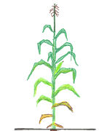
Immobilization
Microbes incorporate mineral N from soil solution into organic compounds in their cells
Soil Organic Matter
Death
NH₄⁺
Soil Microbes
Immobilization
NO₃⁻
Notes:
Microbe uptake of N is very efficient – so efficient that microbes will immobilize available soil N and plant uptake will be limited
Microbes hold N in the population as they decompose SOM then release mineral N as they die off as the carbon source is mineralized to less than 20:1 C:N ratio.
When adding an organic source to the soil that has high carbon and low nitrogen, available mineral N is taken up by the microbes reducing soil available mineral N.

Slide 42
Immobilization
Mineral N to Organic N
Microbe uptake of nitrate is very efficient.
If a high carbon energy source is available, and temperature/moisture conditions are favorable Microbe N uptake can cause crops to be N deficient
Available N
Immobilization
Microbe activity
Time →

Slide 43
Organic Matter Decomposition in Soils
Decomposition rates depend on the source:
  Main Sources: Plant residues (crops, cover crop, compost) and animal manure
  Sources contain different organic carbon compounds depending on crop residue type and age
Sugars, Starches
Proteins
Hemicellulose and cellulose
Woody tissues (lignin)
Rapid decomposition
Slow decomposition
Notes:
Organic matter added to the soil decomposes, releasing N as it does.
Rate of decomposition depends on the composition of the organic matter. The boxed portion of the slide shows the relative rates of decomposition of different forms of organic matter.
Faster decomposition means faster release of N.
(Elements of the Nature and Properties of Soils, 3/e by N. Brady and R. Weil)
sugars, starches, and simple proteins (5%), protein (8%), hemicellulose (18%), cellulose (45%), fats and waxes (2%), polyphenols (2%), and lignin (20%).

Slide 44
Organic Matter C:N Ratios
Material | % C | % N | C:N
Sawdust | 50 | 0.05 | 600
Wheat Straw | 38 | 0.5 | 80
Corn residue | 40 | 0.7 | 57
Rotted Manure | 41 | 2.1 | 20
Broccoli Residues | 35 | 1.9 | 18
Vetch Cover Crop | 40 | 3.5 | 11
Soil Bacteria | 50 | 10 | 5
Slow Decomposition
/Favors Immobilization
20:1 (2% N)
Rapid Decomposition
/Favors Mineralization
Generally: A C:N ratio of 20:1 (2% N) is the dividing line between mineralization (immediate release) and immobilization (N binding and subsequent release).
Notes:
With a large C:N ratio Microbes take N for growth holding N unavailable
As decomposition continues the C:N ratio narrows. At about 20:1 N becomes available for plant use
N can be added to help reduce the effects of high C:N ratio
Source:(Elements of the Nature and Properties of Soils, 3/e by N. Brady and R. Weil)

Slide 45

Nitrogen Cycle- Fertilizer Inputs and Crop Removal
Soil Organic Matter
Crop Residue
Plant Uptake
Organic & Mineral Fertilizer
NH₄⁺
Crop Removal
NO₃⁻
Notes:
Fertilize inputs can be: organic matter, organic N as urea, mineral nitrate, mineral ammonium, or mineral ammonia
Crop removal is a loss from the cycle since it is moved off site
Crops vary in the percent of the N removed by the crop based on the amount of in in the removed portion and the amount remaining as crop residues

Slide 46
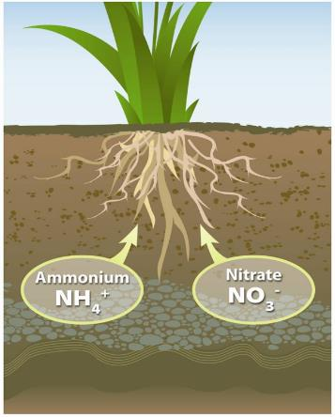
Nitrogen Cycle –Plant Uptake
Ammonium is only available in soils for short periods of time until converted to nitrate.
Therefore, on a whole the most N form taken up is nitrate.
Notes:
Plants vary in the type of nitrogen uptake preference however, ammonium is only available in soils for short periods of time until converted to nitrate
Therefore on a whole, the most taken up form is nitrate.

Slide 47
Nitrogen Assimilation
Nitrogen assimilation is the formation of organic nitrogen compounds like amino acids from inorganic nitrogen compounds
  Assimilation drives plant N uptake
  Plants only assimilate the needed amount plus a small amount of “luxury consumption” ~10-15% of total N
  Thus N available in the soil, that is in excess of plant needs, may be leached to groundwater
Notes:
Assimilation requires energy expenditure, so plants don’t waste energy on making excess organic compounds

Slide 48
Nitrogen and Crop Productivity
Nitrogen availability generally limits crop productivity until adequacy is reached, then response to N plateaus
  Fertilization past a level of adequacy does not increase productivity
Point of Adequacy
Notes:
Fertilization past a level of adequacy does not increase productivity.
The goal is to consider all sources of nitrogen (soil residual, irrigation water, and applied fertilizers) at appropriate times and rates to maximize nitrogen use efficiency and reduce the leaching potential.

Slide 49
Nitrogen in Plants
N in Excess of Demand is Inefficiently Used
Little change
Muhammad, 2013
Notes:
Figure: This example from a high-yield almond orchard illustrates the phenomenon described in the previous slide. At the highest level of N applied, no significant additional N was taken up by the plant compared to the second-highest application level. This treatment level is considered excessive, as we can be sure that N remains in the soil.

Slide 50
Nitrogen in Plants
Excess N Example
(Elana Peach-Fine, MSc. 2013)
Notes:
Figure: Excess N can have negative consequences for plants. Here excess N resulted in increased incidence of hull rot. The exact mechanism is unknown, but rot may be related to N-induced changes in plant defense against fungal invasion.

Slide 51
Nitrogen Cycle Review – Mineralization and Nitrification
Fertilizers
Soil Organic Matter
Mineralization
NH₄⁺
Ammonium
Nitrification
NO₃⁻
Nitrate

Slide 52
Nitrogen Cycle Review –Plants and Microbes
Soil Organic Matter
NH₄⁺
NO₃⁻
Uptake
Immobilization

Slide 53

Nitrogen Cycle Review -losses
Soil Organic Matter &
N Fertilizers
N₂O
NH₃
N₂
NH₄⁺
NO
Volatilization
NO₃⁻
Denitrification
Nitrate Leaching
Notes:
If N is not taken up by plants or microbes it is susceptible to loss
Which N loss pathways are most significant in fruiting crop systems?
Volatilization: This is a very minor component for coastal row crop production but can be a problem for Central Valley cereal crops
Denitrification: This is a minor consideration for Central Valley conditions. However, for growers applying dairy waste products or furrow irrigating, denitrification can be significant.
Leaching/Runoff: Will depend on the magnitude of N accumulation in soil and water to move the N

Slide 54
Nitrogen Fertilizers and Management
Section 3

Slide 55
Section 3 Learning Objectives
Recognize the different categories of nitrogen fertilizers and their composition
Identify their potential for N loss

Slide 56
Nitrogen Source Groups
Ammonium-forming fertilizers
  Form ammonium on reaction with soil moisture or by urease conversion
Ammonium fertilizers
Nitrate fertilizers
Combination fertilizers
Organic materials
  Release mineral N over time through microbial activity
Notes:
More about each type of fertilizer covered in this module

Slide 57
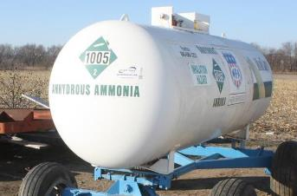
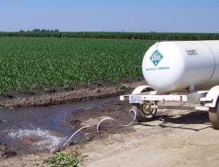
Ammonium-forming Fertilizers
Anhydrous ammonia
When AA contacts water or moist soil, it forms ammonium and hydroxyl ions raising the pH around the application site
NH₃ + H₂O → NH₄⁺ + OH⁻
Notes:
Anhydrous ammonia is the cheapest N source, but using it efficiently is not easy. When it contacts irrigation water or moist soil, it forms ammonium and hydroxyl ions, raising the pH around the site of application or in the water.

Slide 58
Volatilization of Anhydrous Ammonia
How large can losses be?
In a field trial conducted by UC Davis to quantify ammonia volatilization loss from water run AA, they found that:
  Ammonia volatilization averaged 30% of applied N over the whole field
  Ammonium concentration declined down the length of the furrow by more than 50%
    Poor N application uniformity
Notes:
To quantify ammonia volatilization from water-run anhydrous ammonia, UC Davis agronomist Dr. Stu Pettygrove and farm advisors conducted trials in furrow-irrigated fields. Anhydrous ammonia was injected at the head ditch and then sampled down the length of the furrow.
Figure: Ammonium-N concentration decreased significantly down the furrow at all fertigation events. Ammonium concentrations declined by more than 50% down the length of the furrow; when evaluated on a whole-field basis, ammonia volatilization averaged about 30% of applied N. Beyond this significant N loss, the uniformity of N application was very poor.

Slide 59

Ammonium-forming Fertilizers
Urea
Highly soluble and uncharged
  Moves freely through soil with water
Enzymatic breakdown of urea in the soil produces NH₄⁺ and bicarbonate
  Bicarbonate increases soil pH
Rate of hydrolysis increases with temperature and decreases under high application rates
CO(NH₂)₂
NH₃
NH₄⁺
Urea
Hydrolysis
Notes:
Urea is an organic molecule with two N groups attached to a carbon atom. It requires the action of the soil enzyme urease to break it down, forming NH4+ and bicarbonate. Bicarbonate increases soil pH. Initial urea hydrolysis is to increase pH. In total after the NH4 is converted to NO₃ the over all reaction is to decrease pH

Slide 60

Volatilization of Urea
How large can losses be?
When urea is surface applied and not incorporated volatilization losses can be high
  Up to 30% loss in 14 days without rainfall or irrigation
Factors that increase volatilization
  Surface application without incorporation or irrigation
  High temperature and wind speed
  Low soil buffering capacity (sandy soils)
  High pH soils
Notes:
For example, landing on moist soil or drawing dew can cause urea prills to hydrolyze. This raises their surrounding pH, increasing volatilization in the manner described.
Urea volatilization can be agronomically significant.

Slide 61
Ammonium Fertilizers
Ammonium sulfate [(NH₄)₂SO₄] (21-0-0)
Ammonium/phosphorus combinations
  Monoammonium phosphate (MAP)
  Diammonium phosphate (DAP)
  Ammonium polyphosphate (10-34-0)
Ammonium fertilizers are temporarily resistant to leaching until converted to nitrate
  Short timeframe especially in warmer weather
Notes:
Though these forms are temporarily resistant to leaching, this timeframe is likely as short as a matter of days during the summer.
However, they will attach to the soil particles near the surface in the 1st irrigation. Upon conversion they will move with the water front in the 2nd irrigation

Slide 62
Nitrate Fertilizers
Potassium nitrate
Calcium nitrate (CN-9)
Nitrate is negatively charged and moves with the water front
  Most susceptible to N loss via leaching

Slide 63
Combination Fertilizers
Combination fertilizers can provide a rapid availability of nitrate and a continued supply as the ammonium is converted to nitrate.
Ammonium nitrate (NH₄NO₃)
Calcium ammonium nitrate (CAN-17)
  17% N (32% of N as ammonium, 68% as nitrate)
Urea ammonium nitrate (UAN) solutions
  32% N (50% as urea, 25% ammonium, 25% nitrate)
  different concentrations (UAN-28, UAN-32, etc.)
Notes:
Combination fertilizers are heavily used by horticultural crops in California. They act mainly as nitrate fertilizers within days of application.
The fate of ammonium is the same as ammonium forming fertilizers based on the % ammonium.
Combination fertilizers can provide a rapidly availability of nitrate and a continued supply as the ammonium is converted to nitrate.

Slide 64
Organic Materials
Organic materials differ from mineral fertilizers by the rate that N mineralizes and becomes plant available
Sources
  Manure and other animal byproducts
  Cover crops, compost and green waste
Contains both
  Mineral N (immediately available) NH₄ and NO₃
  Organic N (slowly available after microbial conversion)
Notes:
Organic materials differ from mineral fertilizers mostly by the rate at which the N content mineralizes, becoming plant-available. A wide range of organic materials are applied to fields in California, and the differing characteristics (most notably N content, and C:N ratio) impact N availability.

Slide 65
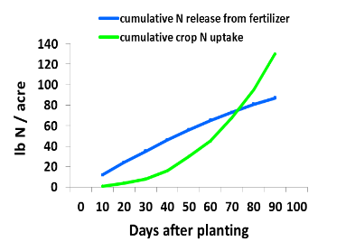
Controlled Release Fertilizers
The release of nutrients can be controlled using an organic coating on fertilizers
Benefits
  Can slow the transformation of NH4⁺ to NO₃⁻
  May reduce leaching potential compared to preplant or single sidedress systems
Drawbacks
  Higher cost per unit of N
  Match between N release
  and crop N uptake is often
  imperfect
  Temperature dependent
Notes:
These products are most effective where fertilization is done by heavy pre-plant or early season applications, with potential for significant leaching from rain or poorly managed irrigation. Their use was limited by their higher cost per unit N. Recently that price disparity has decreased, and products with thinner coating and faster release time have come on the market.
Figure: Here a problem with controlled release products is illustrated. N release is reasonably linear, but crop N uptake is curvilinear. Efficient use depends on choosing a product with the appropriate release characteristic, applied at the right time.

Slide 66
Section 3 Summary
Selecting the appropriate N source for the crop / irrigation management situation can lead to the greatest nitrogen use efficiency.
Reducing nitrogen losses from:
  Volatilization
  Denitrification
  Runoff
  Leaching

Slide 67
Efficient Irrigation Management
Section 4

Slide 68
Section 4 Learning Objectives
Describe the three steps to becoming a more efficient irrigator
  Proper irrigation scheduling
  Measure applied water
  Design and maintain high performing irrigation systems
Recall what causes non-uniformity in irrigation systems and identify methods to address non-uniformity
Identify proper methods for fertigation timing and length of injection

Slide 69
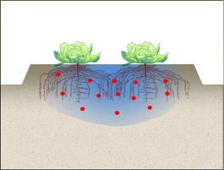
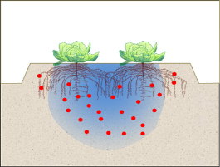
Irrigating Efficiently
Requires supplying the crop water needs while minimizing irrigation losses:
  Percolation of water below the root zone
  Runoff of water
Successful nitrogen management depends on efficient irrigation management
  Excess applied water can cause nitrogen runoff or leaching to ground waters

Slide 70


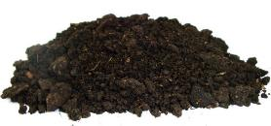
Proper Irrigation Scheduling
Deciding When to Irrigate and How Much to Apply?
  Scheduling aids include measurements of plant water status, soil water status or content and using weather to estimate crop water use.
Plant
Soil
Weather

Slide 71
Irrigation Scheduling
Plant Monitoring Approach
Measure signs of plant water stress to Indicate when to irrigate
Notes:
Traditionally, growers have used early, visual signs of crop stress such as wilting or color change to help decide when to irrigate. Today, technology exists to quantify crop water stress and make informed decisions. Some examples are provided in the above slide.

Slide 72
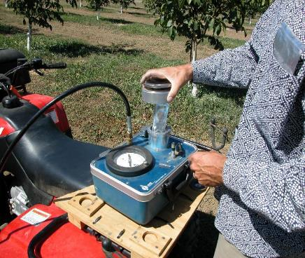
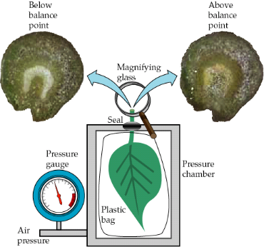
Pressure Chamber
Measures stem water potential, a level of plant water stress, which if used with critical level information can tell you when to irrigate.
Notes:
Pressure bomb. A leaf is cut and placed into the stainless steel cylinder on the left side of the device with the stem sticking out the top. Pressure is applied until moisture is forced out of the stem’s cut surface. The more water stressed the crop, the more pressure is required to exude water from the stem. Guidelines for what a particular crop’s readings mean are available for some of the major irrigated crops in California such as almond, walnut, French prune, wine grapes, and cotton. Some useful references are available at :
1) http://anrcatalog.ucdavis.edu/Details.aspx?itemNo=8503 (walnut, almond, prunes); 2) http://ucanr.org/sites/CE_San_Joaquin/files/35706.pdf (wine grapes) 3) http://www.cotton.org/tech/physiology/cpt/plantphysiology/upload/CPT-v12No2-2001-REPOP.pdf (cotton)

Slide 73
Pressure Chamber
Example
Reading (-bars) | Walnut | Almond
-6.0 to -8.0 | Mild to moderate stress, can affect shoot growth | Low stress, ideal conditions for shoot growth
-10.0 to -12.0 | High stress, wilting of leaves, reduced nut size, defoliation | Mild to moderate stress
-14.0 to -18.0 | Severe stress, defoliation and dying trees | Moderate stress, suggested during hull split
Notes:
Guidelines for almond and walnut note differences in stress levels and symptoms between almond and walnut using -6 to -8 and or -10 to -12 bars

Slide 74
Irrigation Scheduling
Soil Monitoring Approach
Estimates available water in the root zone by measuring how tightly water is held in the soil (water tension) or by estimating water content
Notes:
Since the plant is taking up water applied to and stored in the soil, monitoring soil moisture level can be used to determine when to irrigate and how much water to apply.
When: Soil moisture monitoring techniques range from the simplest “Feel Method” where you squeeze some soil in your hand to get an idea of how wet it is to sophisticated devices that continually monitor the soil moisture. With the most sophisticated sensors and radio telemetry equipment, it is possible for a grower to upload field information real-time and on demand. There are also services available to provide expertise along with the equipment. A review of various soil moisture sensors is available at:
Http://ucmanagedrought.ucdavis.edu/Agriculture/Irrigation_Scheduling/Soil_Moisture_Monitoring/.
How much: This can be answered indirectly by monitoring the soil moisture before and after irrigations. Was the soil profile refilled by irrigation? Was too much or too little water applied? Monitoring devices that allow continuous measurements using a data logger to store the information are extremely useful. The photos show some of the older, less expensive soil monitoring methods, but most can be retrofitted to collect and send continual data.
Note: Soil moisture monitoring can be challenged by soil variability and by limited numbers of sensors. This challenge is more likely to occur with drip irrigation, where moisture can differ drastically over short distances, so representative readings across a field are difficult. It can also be challenged by deeper rooted perennial crops if assumptions about root zone depth are incorrect and if too few sensors are used to monitor moisture in the root zone. This can affect decisions about the “when to irrigate”.

Slide 75
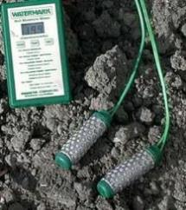
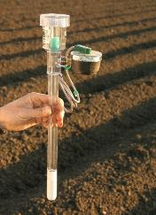
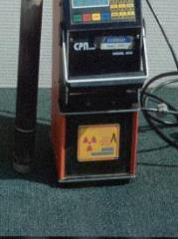
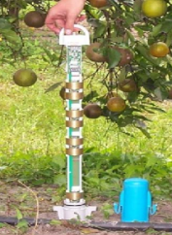
Soil Moisture Monitoring Devices
Electrical Resistance Blocks
Neutron Meter
Dielectric Sensors
Tensiometer
Measure Water Tension
Estimate Water Content

Slide 76
Deciding When to Irrigate
To minimize water stress to the plant, irrigation should occur prior to stored soil a moisture depletion level
Generally assume allowable depletion of 50% of the available root zone moisture
Irrigation
Trigger

Slide 77
Tensiometer Reading Example
Tension | Sand/ Loamy Soil | Sandy Loam | Loam/ Silt Loam | Clay Loam /Clay
(centibars) | Depletion of the Plant-Available Water (%)
10 | 0 | 0 | --- | ---
30 | 40 | 25 | 0 | 0
50 | 65 | 55 | 10 | 10
70 | 75 | 60 | 25 | 20
90 | 80 | 65 | 35 | 25
110 | 85 | 68 | 40 | 32
130 | 87 | 70 | 47 | 38
150 | 90 | 73 | 52 | 43
170 | 95 | 76 | 55 | 46
190 | 98 | 79 | 58 | 49

Slide 78
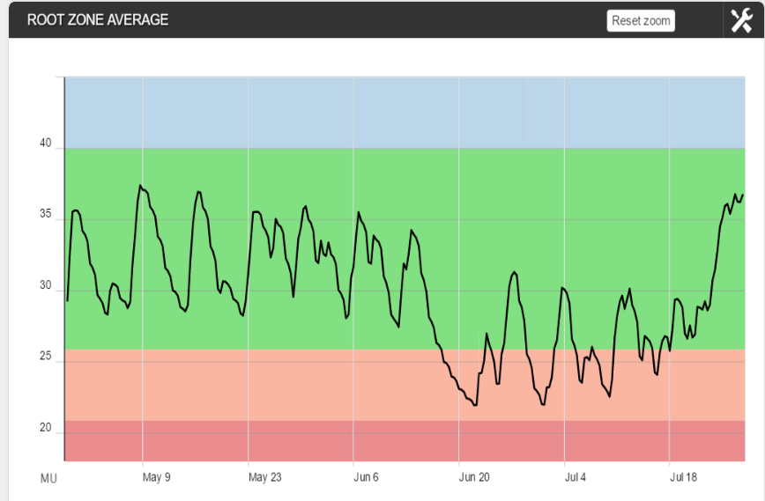
Dielectric Sensor Reading Example
Root zone moisture summation reading as a result of:
crop water use and irrigation
Moisture
Full Point
Onset of Stress

Slide 79

Irrigation Scheduling
Weather Monitoring Approach
Climatic conditions including solar radiation, temperature, humidity, wind speed, drive plant water use (ETc)
Evapotranspiration
Transpiration
Evaporation
Notes:
Climatic conditions, especially solar radiation, drive plant water use (Evapotranspiration or ET). Crop ET can be calculated by modeling the relationship between weather conditions and plant water use. Information from calibrated models is then made available to agricultural and urban water users through newspaper, radio, e-mail, web, etc.
A concise review of irrigation scheduling using crop ET calculations is available at:
http://ucmanagedrought.ucdavis.edu/Agriculture/Irrigation_Scheduling/Evapotranspiration_Scheduling_ET/

Slide 80
Estimating Crop Water Use (ETc)
ETc = Crop Water Use
ETo = Reference Evapotranspiration
  Provided by CIMIS network of nearly 100 weather stations throughout California
Kc Crop Coefficient
  Ratio at which the crop uses water compared to the reference crop (pasture grass)
  Dependent on crop size and age
ET_{c} = ET_{o} x K_{c}
www.cimis.water.ca.gov
Notes:
CIMIS is a network of weather stations, operated by the Department of Water Resources. Information from the stations is collected and used to determine evapotranspiration at each of the station locations.
Note: Reference Crop ET (ET_{O}) is the evapotranspiration of pasture grass. Further calculations are needed to estimate the ET of any particular crop (ET_{C}). ET_{C} must account for canopy development and size of crops.
Crop coefficients are available, especially for the major crops in CA. In general, it is easier to determine the crop coefficients of permanent crops than the crop coefficients of annual crops where planting dates and crop canopy vary.
The amount of water used by the crop since last irrigation is estimated as the crop evapotranspiration (ET_{C}). ET_{C} approximates soil moisture depletion and indicates when and how much to irrigate. Moisture depleted from soil should be replaced with irrigation. This is easier with microirrigation systems where water is being used and replaced frequently.
The crop ET_{c} is determined by multiplying the reference crop ET (Et_{o}) by a crop coefficient (k_{c}). In California, the reference crop ET_{o} is the ET of pasture grass. The crop coefficient is dependent on the crop and its developmental stage.

Slide 81
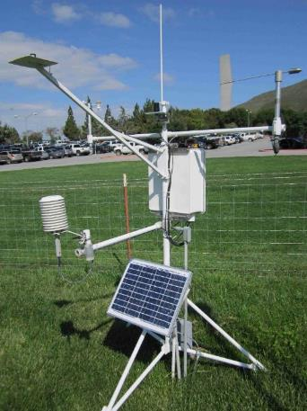
CIMIS and ETo
CIMIS provides real-time and historic ETo estimates
California has 18 reference zones that vary due to climatic factors
www.cimis.water.ca.gov

Slide 82
ET Information
Monthly normal or historical averages can be used for planning irrigations.
However, each season has some variability in water use and can be accounted for by using current year information available though the CIMIS program then adjusting irrigations appropriately.
www.cimis.water.ca.gov

Slide 83
Crop Coefficients (Kc)
For annual crops Kc’s are closely related to the plant coverage which increases from planting over the season until fresh harvest or declines with late harvested crops.
For trees and vines Kc’s increase beginning at leaf out and decline towards leaf drop. Kc’s can be over 1.0 due to their tall stature and being planted in rows.

Slide 84
Crop Water Use (ETc)
Example: Historical Monthly ETo, Almond ET Zone 12
 | Kc | ETo | ETc
Mar | 0.62 | 3.41 | 2.11
Apr | 0.80 | 5.10 | 4.09
May | 0.94 | 6.82 | 6.44
Jun | 1.05 | 7.80 | 8.20
Jul | 1.11 | 8.06 | 8.93
Aug | 1.11 | 7.13 | 7.90
Sept | 1.06 | 5.40 | 5.73
Oct | 0.92 | 3.72 | 3.41
Nov | 0.69 | 1.80 | 1.23
 |  |  | 47.43
Notes:
D. Doll and K. Shackel. 2015. Drought tips: Drought management for California almonds ANR 8515
Zone 12 Crop Water use for Almonds
Crop Season: March 1 to Nov 15

Slide 85
Meeting Crop Water Use (ETc)
Stored Soil Moisture
  Plant-available at the beginning of the season as a result of rainfall or off-season irrigation (measured or estimated)
  In-season effective rainfall
    Rainfall that is stored in the root zone
Applied Irrigation Water
$$=Crop Water Use \left(ETc\right)− \frac{Stored Soil Moisture}{2}−Effective Rainfall$$
Notes:
Only about one half of the available water can be used before significant crop water stress slows growth.
Therefore use : $\frac{Stored Soil Moisture}{2}$

Slide 86
Estimating Stored Soil Moisture
Root Zone Water-Holding Capacity
  Controlling factors:
    Soil texture and structure
    Depth of root zone
Effective Winter Rainfall
  Controlling factors:
    Rainfall Amount
    Environmental (climate) evaporative demand
Water stored in the rootzone cannot exceed the total root zone water holding capacity
Notes:
Root extensiveness refers to the crops access to soil moisture.
Examples are a young orchard where roots are limited to a smaller area than the tree spacing
Annuals when plants are young

Slide 87
Capacity of the Soil to Store Water
Stored Soil Moisture Capacity (in) | = | Plant Available Water-holding Capacity (in/ft) | x | Rooting Depth (ft)
Soil Texture | AWC (in water/ft soil)
Very coarse sands | 0.4 - 0.75
Coarse sands, fine sands, loamy sands | 0.75 - 1.25
Sandy loams, fine sandy loams | 1.25 - 1.75
Very fine sandy loams, loams, silt loams | 1.50 - 2.30
Clay loams, silty clay loams, sandy clay loams | 1.75 - 2.50
Sandy clays, silty clays, clays | 1.60 - 2.50
Notes:
The rooting depth may be affected by the soil depth, constraining soil layers (hardpan, plowpan, etc.), or even abrupt changes in soil texture. When in doubt about the soil profile or rooting depth, use a soil auger or better yet a backhoe, to determine the rooting depth and soil profile textural characteristics.
ucmanagedrought.ucdavis.edu/Agriculture/Irrigation_Scheduling/Evapotranspiration_Scheduling_ET/Frequency_of_Irrigation/Crop_Rooting_Depth/

Slide 88
Estimating Effective Winter Rainfall
In the beginning of the growing season, perennial crops as well as early planted annuals water requirements can often be met by:
  Stored soil moisture from non-growing season rainfall
  In-season rainfall
Effective Winter Rainfall relies on the use of total monthly rainfall and monthly ETc during the non-growing season
$$Effective Winter Rainfall=Monthly Rainfall −Monthly ETc$$
Notes:
Since the crop is not using water the ETc is actually just the evaporative demand (E)

Slide 89
Estimating Effective Winter Rainfall
Example
$$Monthly Rainfall −Monthly ETc=Effective Winter Rainfall$$
ET Zone 12 Merced 2016
 | Monthly Rainfall (in) | Monthly ETc (in) | Effective Rainfall (in)
Nov 16-30 | 0.92 | 0.61 | 0.31
Dec | 2.23 | 0.40 | 1.83
Jan | 2.75 | 0.50 | 2.25
Feb | 2.36 | 0.81 | 1.55
Total |  |  | 6.0
Notes:
The ETc table is slide number xx almond ETc

Slide 90
Estimating Stored Soil Moisture
From Winter Rainfall Example
Almond orchard in Merced
  clay loam soil available water holding capacity = 2.0 in/ft
  4ft crop rooting depth
  total effective winter rainfall = 6.0 in
6.0 in of rainfall will be stored in the soil
  Only about ½ of the available 6.0 in can be used before inducing crop stress therefore 3.0 in (6.0 / 2) can be used for scheduling
  If post harvest irrigation or frost protection water was applied, it should be added up the 8.0 inch maximum
2.0 in/ft | x | 4 ft | = | 8.0 in | > | 6.0 in

Slide 91
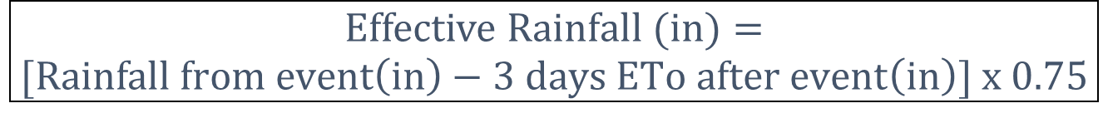
In-Season Effective Rainfall
In-season rainfall, that enters and is stored in the root zone, called effective rainfall, should be accounted for when scheduling irrigation
$$Effective Rainfall (in)=$$
$$[Rainfall from event\left(in\right)−3 days ETo after event\left(in\right)] x 0.75$$

Slide 92
In-Season Effective Rainfall
Example
Merced CIMIS Station 148, April 8–10, 2016:
  Rainfall from event: 2.65 in.
  ETo April 11-13: 0.5 inches
$Effective Rainfall \left(in\right)=\left(2.65 in−0.5 in\right)x 0.75=$ 1.6 in

Slide 93
Irrigation Scheduling
Using stored winter rainfall and in-season effective rainfall
 | ETc | = | In-Season rainfall (in) | Stored Moisture (in) | Irrigation Application (in)
Mar | 2.1 |  | 2.1 | 0 | 0
Apr | 4.1 |  | 1.6 | 1 | 1.5
May | 6.4 |  | 0 | 1 | 5.4
Jun | 8.2 |  | 0 | 1 | 7.2
Jul | 8.9 |  | 0 |  | 8.9
Aug | 7.9 |  | 0 |  | 7.9
Sep | 5.7 |  | 0 |  | 5.7
Oct | 3.4 |  | 0 |  | 3.4
Nov 1-15 | 0.6 |  | 0 |  | 0.6
Season | 47.3 | = | 3.7 | 3.0 | 40.6
Notes:
Note that the available stored moisture is 3.0 in which is 50% of the rootzone stored water of 6.0 in. An accepted irrigation level to prevent water stress.
Soil Storage and In-season effective rainfall contributed to 32% of the March through June water use period and a 14 % on a seasonal basis
The point of this visual is : even though the ET is 47.3 in the applied irrigation water is only 40.4 in
March: Effective rainfall equaled ETc so no soil storage was used
April: Effective rainfall was a portion of the ETc so 1/3 of the stored moisture was used in addition to some irrigation to equal the ETc.
May: No effective rainfall 1/3 of the total stored soil moisture was used along with 5.4 in Irrigation
June: the last od the stored moisture was used and 7.2 in Irrigation was applied
July- Nov 15: Irrigation was used to meet ETc

Slide 94
Applying the Irrigation
Monthly irrigation amounts should be scheduled based on:
  A frequency to minimize plant water stress
  A duration based on water infiltration characteristics and irrigation system application rate
Irrigation System | Typical Frequency During Peak Water Demand
Drip | Daily
Microsprinklers | 3-4 days
Sprinklers | 10-14 days
Furrow | 14+ days

Slide 95
Meeting Crop Water Use (ETc)
Micro-irrigation System Example
Almonds on micro sprinklers for July near Modesto
1. Determine Irrigation Frequency : every 4 days
2. Determine Crop Water Use ETc
historical ET July 1-31 = 8.9 in
3. Determine Application Amount
8.9 in. | ÷ | 31 days | = | 0.29 in/day
0.29 in/day | x | 4 days | = | 1.15 in

Slide 96

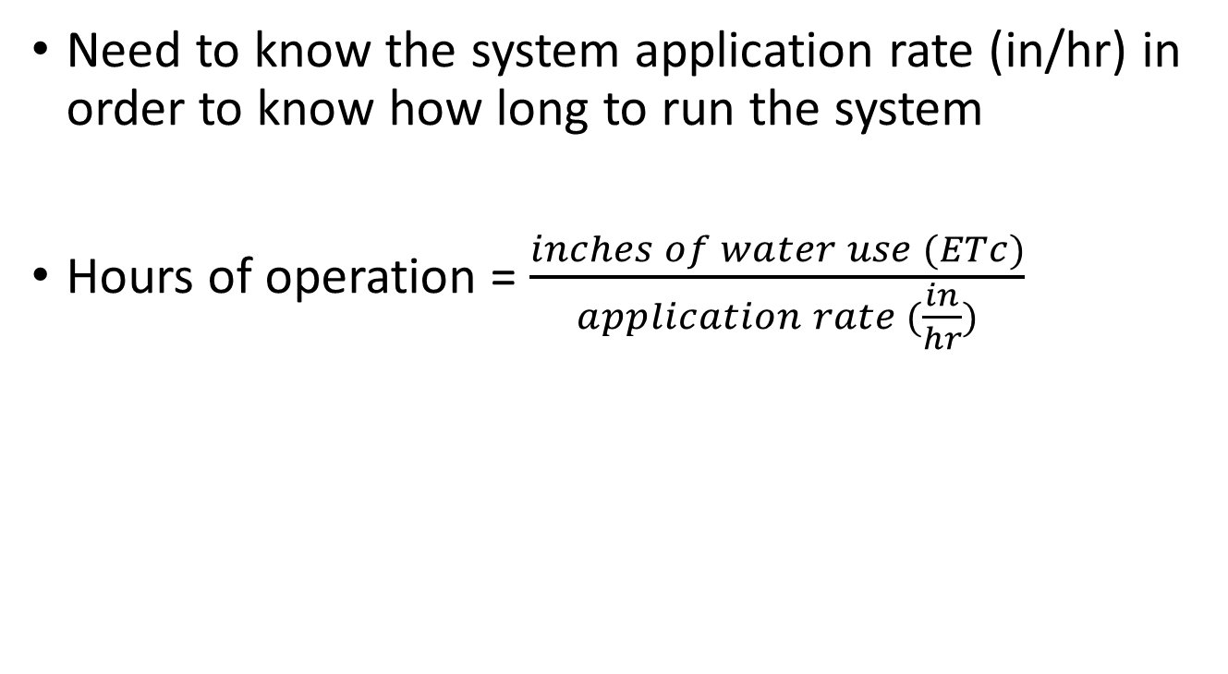
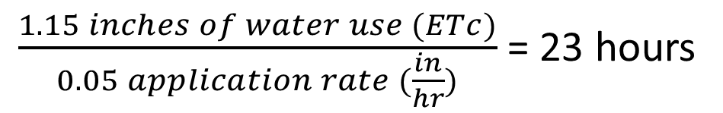
Meeting Crop Water Use (ETc)
How long to run the system?
Need to know the system application rate (in/hr) in order to know how long to run the system
Hours of operation = $\frac{inches of water use (ETc)}{application rate (\frac{in}{hr})}$
$\frac{1.15 inches of water use (ETc)}{0.05 application rate (\frac{in}{hr})}$ = 23 hours

Slide 97
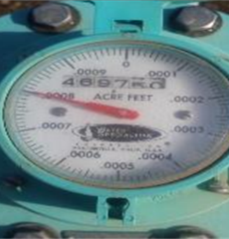
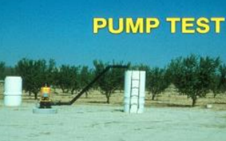
Determining Applied Water
Gallons per Acre (gal/acre)
Flow meter
  Meter flow rate x time of operation / acres
Pump Test
  Pump flow rate x time of operation / acres
*Flow rate and time of operation must be in the same time unit
Notes:
Meters:
Propeller flow meters can be used to measure water in pipelines or tubing, but they are not appropriate for open channels. Velocity meters, weirs, and flumes are better suited for measuring water in open channels but require additional expertise.
One of the greatest challenges of using a flow meter is to relate flow information - in gallons, cubic feet per second, acre-inches, or acre-feet of water - to the crop ET information, given in inches per day, inches per week or even inches per month.
Emitter Flow:
Collect a easily measurable amount of water in a given time frame. Measure the volume to determine flow per unit time– ie gal/hr
How do you know how many nozzles per acre? Growers all know the number of trees per acre– so when every other tree has a sprinkler – trees per acre / 2 = nozzles per acre

Slide 98
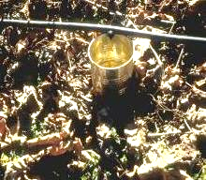
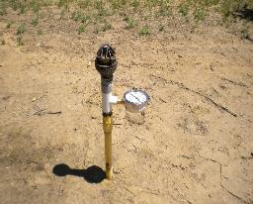
Determining Applied Water
Gallons per Acre (gal/acre)
Emitter flow rate
  Emitter flow rate x emitters per acre x time of operation
Use Manufacturers flow rates
  Flow rate at operational pressure x time of operation x nozzles/acre
*Flow rate and time of operation must be in the same time unit
Notes:
Meters:
Propeller flow meters can be used to measure water in pipelines or tubing, but they are not appropriate for open channels. Velocity meters, weirs, and flumes are better suited for measuring water in open channels but require additional expertise.
One of the greatest challenges of using a flow meter is to relate flow information - in gallons, cubic feet per second, acre-inches, or acre-feet of water - to the crop ET information, given in inches per day, inches per week or even inches per month.
Emitter Flow:
Collect a easily measurable amount of water in a given time frame. Measure the volume to determine flow per unit time– ie gal/hr
How do you know how many nozzles per acre? Growers all know the number of trees per acre– so when every other tree has a sprinkler – trees per acre / 2 = nozzles per acre

Slide 99
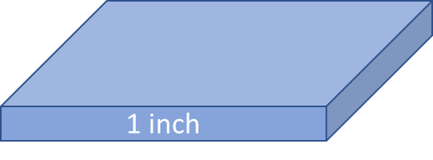
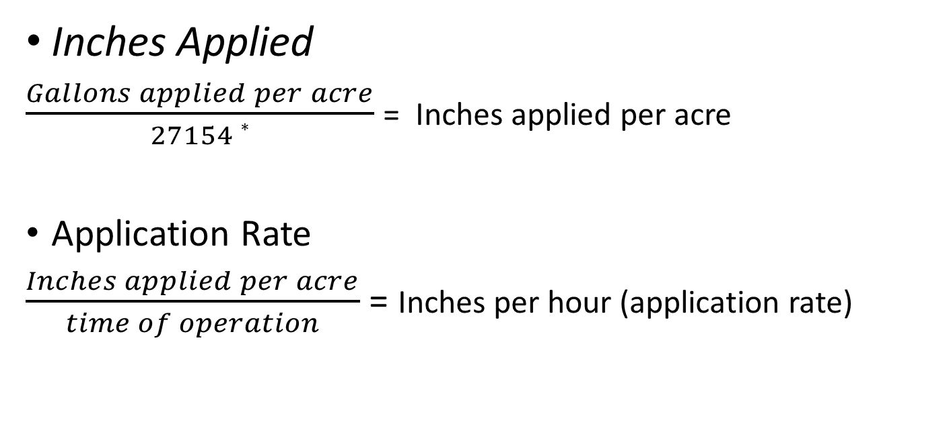
Determining Applied Water
Convert From Gallons per Acre to:
Inches Applied
$\frac{Gallons applied per acre}{27154 ∗}$ = Inches applied per acre
Application Rate
$\frac{Inches applied per acre}{time of operation}$ = Inches per hour (application rate)
* 1 inch of water on 1 acre = 27154 gallons
1 acre = 43560 sq ft

Slide 100
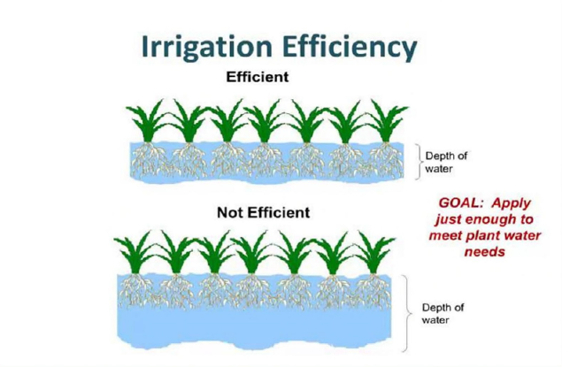
Irrigation Efficiency (IE)
How well you—the irrigator—apply the correct amount of water to satisfy crop water use
If all the applied water is used by the crop IE = 100%
Water Losses reduce IE:
Deep percolation below root zone in excess of that required for salt leaching or Surface runoff that is not reused

Slide 101


Irrigation Uniformity
A measure of how evenly water is applied to the field
Poor uniformity means that portions of the field are getting less water than others.
  Causes poor plant performance due to water logging and nitrate leaching or plant water stress
Good Uniformity
Poor Uniformity
(Never perfect)
Application Depth
Notes:
The second goal is to evaluate how evenly the water is applied, which indicates where in the field lies the greatest leaching risk.
Irrigation efficiency is given as percentage with 100 % being perfect.
Irrigation efficiency is quantified using various measures including Distribution Uniformity (DU), Coefficient of Uniformity (CU), and Emission Uniformity (EU), but knowing the general concept is more important than the details about the different measurement methods of irrigation uniformity.
Poor irrigation uniformity means that portions of the field are getting less water than others. Most growers do not want to under-irrigate even a portion of the crop, so they irrigate to make sure the area receiving the least water gets enough. With non-uniformity, some portions of the field receive too much water. Too much water leads to deep percolation losses (leaching of water), and if nitrate is in the soil profile, it can be leached with the water. Thus, poor irrigation uniformity makes N leaching more likely.

Slide 102
Irrigation Efficiency and Distribution Uniformity
Irrigation Efficiency
Presuming we estimate crop water use and apply that amount of irrigation without deep percolation or runoff losses. We have good efficiency
Distribution Uniformity
The distribution uniformity is often calculated when performing an irrigation audit.
Measure flows or pressures at the emitters or sprinklers
DU = Ratio of lowest quartile to population average

Slide 103
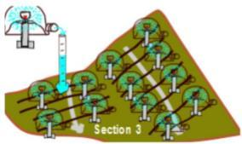
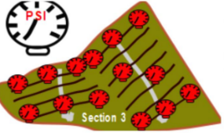
Measuring DU
Mobile irrigation lab
  Several RCDs offer DU testing
DIY
  Use a graduated cylinder and stopwatch to measure emitter/sprinkler flow at various points in the system
  Use a pressure gauge to measure uniformity of pressure across the field

Slide 104
Distribution Uniformity
Average applied water volume
The 75 % DU over and under applies 30 % of the average.
The 90 % DU over and under applies 11% of the average.
Notes:
Example of two DU’s 75 % and 90 %
X axis (bottom) is fractions of the field. 0.125 is 1/8th of the field in increments.
The 1/8th on the left is the low water applied 1/8th. The 1/8th on the right is the high water applied 1/8th.
The 0.5 or 50% id the average water applied.
The 75 % DU under and over and under applies 30 % of the average.
The 90 % DU under and over and under applies 11% of the average.

Slide 105
Using a Distribution Uniformity
(DU) Test Results
The solution lies in improving DU to a point where there is minimal difference in the over and under-irrigation levels of the field and not to simply increase the applied water to ensure all areas get the desired amount.
A DU of about 90% is ideal, as research has shown that trees for example are able to produce optimally with about 90% of full irrigation *.
Fields with lower DU should be analyzed to determine the problem and solutions implemented to improve DU.
* Shackel, K. et.al.2017 ABC Water Production Function Report

Slide 106
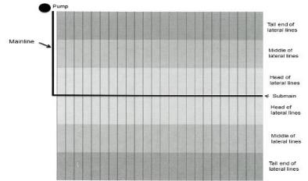
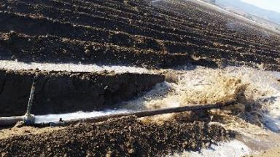
Improving Irrigation Efficiency and Distribution Uniformity
Improved Irrigation Design
Irrigation System Maintenance

Slide 107
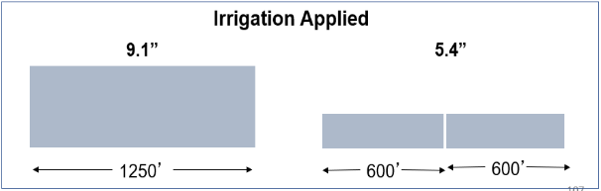
Surface Irrigation Design
Improvements
Shortening field length
Increased field slope
5.1”
Irrigation Applied
4.8”
0.1% slope
0.2% slope
Notes:
Shortening field length can significantly improve furrow irrigation, though the prospect is not always well-received by growers. Shorter field lengths necessitate use of tailwater return systems and mean more labor and frequent set changes. Longer fields with less turning around of equipment can be more cost effective. Overall, shorter field lengths tend to be more expensive and less convenient to farm but they improve irrigation uniformity.
In this example, cutting the field length in half resulted in needing only about half of the irrigation amount. Decreasing field length is usually the best method of sustaining higher flows per square foot of wetted area and accomplishing faster advance across the field. Irrigation set times must be reduced accordingly to realize efficiency. More information on this study and some others can be found here: http://cetulare.ucanr.edu/files/170597.pdf
Increasing Slope:
In this example, increasing field slope decreased the amount of irrigation water necessary to irrigate the field, though it was not as effective as field length reduction. Changing field slope is often the first design feature considered.

Slide 108
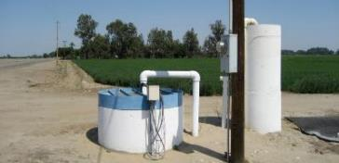
Surface Irrigation Design
Improvements
Increase border check flow per foot of check
  Same flow on two check widths
Collect and reuse tailwater runoff
Irrigation Applied
5.1”
4.3”
Wide Check (200’)
Narrow Check (100’)
Notes:
In this example, increasing flow per foot of check decreased the amount of water used. Irrigation set times must be changed to take advantage of the increased flow rate on to the field.
Note: Increasing flow in furrow systems tends to be even less effective than for border flood because it increases the depth of water in the furrows and the wetted soil surface. Increasing flow into a flood or furrow system is usually not as effective as reducing field length.
Tailwater return systems work in concert with the other improvements discussed that advance irrigation water more rapidly and apply water more uniformly with less deep percolation.
An additional benefit of tailwater reuse is that it keeps tailwater, and any chemicals or constituents in it, on the grower’s land. The Irrigated Lands Regulatory Program applies to water leaving a grower’s land, so keeping water for reuse satisfies the regulation.

Slide 109
Pressurized Irrigation Design
Improvements
Use appropriate pressure regulators, filters, and emitters for system
Use pressure-compensating (PC) drippers, microsprinklers, and sprinklers when pressure variations occur
  Provide nearly constant discharge rate across a range of operating pressures
Consider pipe sizing and how that affects pressures at emitter due to friction losses
Notes:
Once the system reaches a minimum pressure, pressure compensating (PC) drippers microsprinklers and sprinklers make discharge rates less sensitive to pressure variations.
PC drippers and microsprinklers are therefore a good tool to be used where there will be pressure differences in the irrigation system due to elevation changes or due to frictional pressure losses in the system

Slide 110
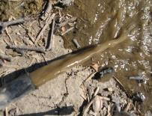
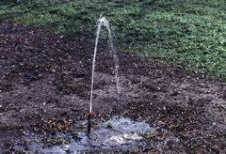
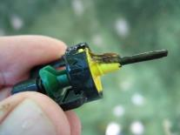
Irrigation System Maintenance
Pressurized systems
Clean and flush filters, mainlines, submains and lateral lines regularly
Walk the field and monitor for leaks and breaks frequently
Check emitters for physical particles, biological and chemical clogging at least twice per season
Notes:
Clogging problems are most easily detected by a system evaluation which will pick up the clogging of microirrigation emitters. Delaying until emitters stop discharging due to complete clogging makes maintenance approaches to cure the problem very difficult.
Clogging can also be detected by closely monitoring the flow rate, using a flow meter, of the system. Decreasing system flow rate, measured at the same operating pressure, indicates that clogging is likely occurring.

Slide 111
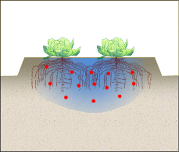
Fertigation
Inject N during the middle to near end of an irrigation event
  Early injection can result in nitrogen moved out of the root zone
  Late injection can result in fertilizer left in the system which can foster biological growth and cause plugging
Notes:
Whatever injection equipment is used, it is important to time the injection so that the injected material stays in the crop’s root zone.
Remember that there needs to be a period of clean water irrigation following an injection so that the chemical is applied uniformly and there is not material left in the lateral lines.

Slide 112
Fertigation
Injection Timing
Injections should last at least 1 hour* for uniform application
  When products are injected too quickly, there is insufficient time to distribute the fertilizer uniformly
At least 1 hour* of clean water should follow to ensure uniform application.
  All fertilizer should leave the lines
  *depending on length of lines, shorter lateral lines may require less time for application and flush and longer lateral lines may require additional time.
Notes:
Note: For row crops, longer times assume longer rows and larger irrigation sets. Longer means longer than the 1 hour recommendation for tree and vine systems. When fertilizers or other water treatment products are injected too rapidly, there is insufficient time to distribute the fertilizer uniformly across the field. If fertilizer injections are not followed with adequate water, the fertilizer application will not be uniform, and fertilizer may be left in the system to drain randomly, usually at lower elevations. Additionally, remaining fertilizer can foster biological growth and cause plugging.
ANR Publication 21599 Chemigation in Trees and Vines

Slide 113
Managing Salinity
Leaching salts and not nitrate
Periodic soil and irrigation water testing will help determine when leaching is needed
  Leaching is not necessary every irrigation or perhaps even every season but only when soil salinity crop tolerances are approached.
Leaching is most efficient in the winter and should not coincide with critical periods of nitrogen uptake and fertilization
Notes:
These are tips to consider when it is necessary to leach salts but not not nitrate from the soil profile. Salinity leaching may or may not be needed every season. Soil and water testing will help determine when leaching is necessary and how much is needed. In general, irrigating with high salinity water or under-irrigating may lead to a greater need for salinity leaching. To the extent possible, time irrigations to leach salinity during fallow or dormant periods. This will avoid periods of crop growth and development when nitrogen is needed.

Slide 114
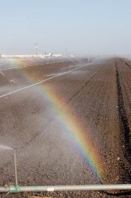
Section 4 Summary
Efficient irrigation practices are critical to good nitrogen management
How do you become a more efficient irrigator?
  Use weather, soil moisture, or
  crop water status information
  to understand irrigation needs
  Measure applied water
  Design and maintain high
  performing irrigation systems
Notes:
Good Irrigation Water Management (putting on the correct amount of water, at the correct time, with an efficient irrigation system) is critical to good nitrogen management. Bottom line is that if you minimize the amount of water you leach, you minimize nitrate leaching. We talked about ways to accomplish this.

Slide 115
Efficient Nitrogen Management
Section 5

Slide 116
Section 5 Learning Objectives
Identify the 4R nitrogen management practices
Apply the right rate equation to determine crop N demand
Recognize the benefits of increasing Nitrogen Use Efficiency (NUE)
Recall the components needed to calculate N contribution of organic materials
Interpret lab reports to determine N contribution of irrigation water

Slide 117
Applying the 4R Principle
Right Rate
Match supply with crop demand
Apply coincident with crop demand and uptake
Right Place
Ensure delivery to active root zone
Right Source
Supply nitrogen in plant available form
Right Time
Notes:
Details about each of the 4Rs:
Right Rate:
1. Appropriately assess soil nutrient supply
2. Assess all available indigenous nutrient sources
3. Assess plant demand
4. Predict fertilizer use efficiency
Right Time:
1. Assess timing of crop uptake
2. Assess dynamics of soil nutrient supply
3. Recognize timing of weather factors
4. Evaluate logistics of operations
Right Place:
1. Recognize root-soil dynamics
2. Manage spatial variability
3. Fit needs of tillage system
4. Limit potential off-field transport
Right Source:.
1. Supply in plant available forms
2. Suit soil properties
3. Recognize synergisms among elements
4. Blend compatibility
Note: Information on choosing the “Right Source” will be discussed in Section 3

Slide 118
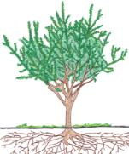


Apply the Right N Rate
The right rate equation
Demand
Supply
Crop N Demand
N in soil
N in irrigation water
N in fertilizer
Use the right rate equation to avoid excess N, increase nitrogen use efficiency, and increase profitability by accounting for all N inputs.

Slide 119
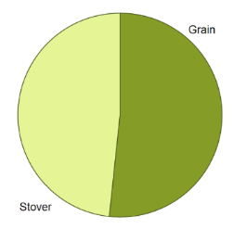
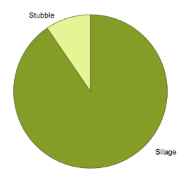
Right Rate: N Demand
How to determine crop nitrogen demand
Approach depends on proportion of N removed from the field during harvest and N left in the field as crop residues or perennial tissue
Example: grain corn vs silage corn
N left in field
N removed

Slide 120
Right Rate: N Demand
Crop | Yield | Removal Rate | Total N Removed
Corn silage | 30 ton/acre | 7.56 lbs. N/ton | 227 lbs. N/acre
Corn grain | 6 ton/acre | 24 lbs. N/ton | 144 lbs. N/acre
The difference is the amount of N in the Stover 83 lbs. N/acre
If grain corn is provided with only 144 lbs. N/acre (N removed) reduced yield will occur
  Therefore, N should be provided to make up for N removed + N in crop residue
Notes:
To look up nutrient demand for the harvested portions of other crops, please visit https://www.ipni.net/app/calculator/home
This slide makes two points.
Nutrient removal rates are available
The grain corn example points out that the N used (grain and stover) for the grain corn is most appropriate while N removed is appropriate for silage corn
Yield for Corn silage = 30 t/acre x 10 lbs N/ton = 300 lbs N /acre
Yield for Corn grain = 6 t/acre x 24 lbs N/ton = 144 lbs N /acre
The difference is the amount of N in the stover 156 lbs N / acre

Slide 121
Right Rate: N Demand Examples
ALMOND
PISTACHIO
Nonpareil
N removal 68 lb per 1000 kernels
Monterey
N removal 65 lb per 1000 kernels
Growth Requirement
Yield 2,000-4,000 = 0 lb N
Yield 1,000-2,000 = 20 lb N
Yield <1,000 = 30 lb N
Kerman:
N removal 28 lb per 1000*
Growth Requirement:
On-year: 25 lb N
Off-year=25-40 lb N
*Dry CPC assessed yield
Walnut
N removal 19 lb per 1000 lb in shell
8% moisture
Growth Requirement:
Mature orchard = included in above
Immature orchard: not yet available
Notes:
If yield is unpredictable, begin by using an approximation to determine the first 20% of N needed. Then calculate the remaining fertilization needed after the crop is on the tree, giving a much more accurate estimate of yield for the rest of the season.

Slide 122
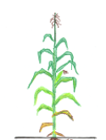

Right Rate: N Demand
Nitrogen Use Efficiency (NUE) when most N is removed by crop
$$NUE=\frac{Lbs N removed by crop}{Lbs N applied all sources}$$
Examples: silage corn & mature orchards
Notes:
Doesn’t include the N used in the crop residues. Works best with steady state perennials or monoculture.

Slide 123


Right Rate: N Demand
Nitrogen Use Efficiency (NUE) when only part of N is removed with crop
$$NUE=\frac{Lbs N removed by crop+N for growth }{Lbs N applied all sources}$$
Examples: immature orchards
Notes:
Doesn’t include the N used in the crop residues. Works best with steady state young perennials

Slide 124


Right Rate: N Demand
Nitrogen Use Efficiency (NUE) when only part of N is removed with crop
$$NUE=\frac{Lbs N removed by crop+N in crop residue}{Lbs N applied all sources}$$
Examples: grain corn, tomatoes, vegetables
Notes:
Includes the N used by the crop for harvested and N content of crop residue Works well with annual crop rotations.
This is a more difficult method as N removed and N in the crop residue is used to calculate N demand

Slide 125
Right Rate: N Demand
Nitrogen Use Efficiency (NUE)
What is a reasonable NUE ?
  Achievable NUE= 70% (More of a target)
  Average worldwide < 50%
The highest efficiency is achieved by a combination of right rate, right time, right place and right source.
Management of croplands to minimize Losses via volatilization, denitrification, runoff and leaching
Notes:
Cassman, Kenneth G.; Dobermann, Achim R.; and Walters, Daniel T., "Agroecosystems, Nitrogen-use Efficiency, and Nitrogen
Management" (2002). Agronomy & Horticulture -- Faculty Publications. Paper 356.
http://digitalcommons.unl.edu/agronomyfacpub/35

Slide 126
Right Rate: N Demand
Methods for Setting Realistic Yield Goals
Use experience of the potential of a particular field and then consider environmental conditions.
  For annuals, weather at planting can have a major effect.
  For perennials, the past year’s yield plus winter and spring weather can be critical.
Set target of 10% above the field’s 3-5 year average, excluding years with unusual negative conditions
  Caution: Estimating too high of a yield can result in over application
Notes:
With the more than 100 crops grown in California, it is hard to provide a uniform approach to yield estimation. The best approach is likely to use your own experience to guide you, bearing in mind that getting a yield estimate wrong at the beginning of the year can result in substantial difficulty later in the year.

Slide 127

Right Rate: N Demand
N removal rates
Provides an overview of N removed in harvested plant parts for field crops, vegetables, and tree and vine crops.
https://apps1.cdfa.ca.gov/FertilizerResearch/docs/Geisseler_Report_2016_12_02.pdf

Slide 128



Right Rate: N Demand
Estimating total demand example: tomato
N removed per unit of crop yield
N in crop residue
Estimated Yield
Nitrogen Use Efficiency
Crop N Demand

Slide 129

Right Rate: N Demand
Estimating total demand example: Processing Tomato
N removal with crop = 2.73 lbs. N/ton fresh weight
N left in field with crop residue 1.17 lbs. N/ton
Yield expected is 50 tons per acre
Estimated crop demand?

Slide 130




Demand Function
Estimating total demand Example: Processing Tomatoes
$$\frac{2.73 lbs. N }{ton yield}$$
$$\frac{1.17 lbs. N}{ton}$$
$$\frac{50 tons yield}{acre}$$
0.7
$$\frac{278 lbs. N}{acre}$$

Slide 131


Apply the Right N Rate
The right rate equation
Demand
Supply
$$\frac{278 lbs. N}{acre}$$
Residual N in Soil
N mineralized in soil
Irrigation water
Fertilizer

Slide 132
Right Rate: N Supply
N in the Soil
Soil Nitrate Testing should be performed at planting or before side-dress
  Testing through lab
  Nitrate Quick Test
Example
  results = 20ppm NO₃-N in dry soil
  20 x 4 = 80 lbs. N/ac available in top foot of soil
Notes:
Note: Currently, we do not do soil mineral N tests for perennial crops because the amount of N cycling through from dropped leaves and prunings is such a small percentage of the overall N. This test is much more important for annual crops.

Slide 133
Apply the Right N Rate
The right rate equation
Demand
Supply
$$\frac{278 lbs. N}{acre}$$
N mineralized in soil
Irrigation water
80 lbs. N /acre
Fertilizer

Slide 134

Right Rate: N Supply
N Mineralized in the Soil
Organic matter applied to the soil, in-season, such as manure, compost, or cover crop residue will release N over time (mineralization)
  N released will become available to plant for uptake

Slide 135
Right Rate: N Supply
N Mineralized in the Soil
Single application of organic matter
  N credits = dry lbs. OM x % N x % decomposition 1st year
Consistent application OM or growing of cover crop
  N Contribution = Dry lbs. OM x % N x 70%
First Year Decomposition Rates
Cured Compost | 5-10%
Dried Manure | 20-30%
Cover Crop | 10-35%
Lagoon Water | 40-50%
Notes:
About 70% of the organic N will be mineralized over time– the rest is subject to losses.
Reference: Lentz and Lehrsch Net Nitrogen Mineralization from past year’s Manure and Fertilizer Applications 2011, Soil Sci. Soc. Am. J. 76:1005–1015

Slide 136
Continual application of the same amount of organic N each year 43 lbs N / acre
In each subsequent year of application the available mineral N increases and a steady state is approached after about 4 years.
Notes:
Example is for a cover crop at 43 # N / acre each year
In each subsequent year of application the available mineral N increases
Note how a steady state is approached after about 4 years.
The rate at which the materials decay can be different due to:
Material N content
C:N ratio
Temperature
Moisture content of soil
Level of soil incorporation
Reference: David Crohn Proceedings, National Alfalfa Symposium, 2004

Slide 137
Right Rate: N Supply
N Mineralized in the Soil
Example
  1st year applying cured compost @ 5 tons/ac
    Expected 1st year decomposition rate 7.5%
    % N estimated from lab report 2%
    N credit = 10,000 lbs compost /ac x 0.02 x 0.075
    N credit = 15 lbs N /ac

Slide 138
Apply the Right N Rate
The right rate equation
Demand
Supply
$$\frac{278 lbs. N}{acre}$$
Irrigation water
80 lbs. N /acre
15 lbs. N /acre
Fertilizer

Slide 139
Right Rate: N Supply
N in irrigation water
Formula for Nitrate-N
Nitrate-N concentration (ppm) x inches irrigation applied x 0.23
Example
  2.3 ppm Nitrate-N and you apply 36 in. of water
    2.3 x 36 x 0.23 =
    19 lb N per 36 inches of water applied
Notes:
N in water is a free and very readily available nitrogen source.
Note: The conversion factors .052 and 0.23 are constants used to convert from N concentration in ppm to lbs.
When Nitrate concentration is measured in nitrate-N (NO3--N), only the nitrogen is measured.
When Nitrate concentration is measured in nitrate (NO3-), nitrogen and oxygen are both measured.
Note 1 : The two maximum contaminant levels are the same – only difference is the mg/L is the weight on N and O3 versus N .
A factor of about 4.5
62.0049 / 14.0067 = 4.427

Slide 140


Right Rate: N Supply
N in irrigation water
What if your lab report lists your water as Nitrate (ppm)?
Formula for converting Nitrate to Nitrate-N
Nitrate (ppm) ÷ 4.43 = Nitrate-N (ppm)
Notes:
N in water is a free and very readily available nitrogen source.
Note: The conversion factors .052 and 0.23 are constants used to convert from N concentration in ppm to lbs.
When Nitrate concentration is measured in nitrate-N (NO3--N), only the nitrogen is measured.
When Nitrate concentration is measured in nitrate (NO3-), nitrogen and oxygen are both measured.
Note 1 : The two maximum contaminant levels are the same – only difference is the mg/L is the weight on N and O3 versus N .
A factor of about 4.5
62.0049 / 14.0067 = 4.427

Slide 141
Apply the Right N Rate
The right rate equation
Demand
Supply
$$\frac{278 lbs. N}{acre}$$
80 lbs. N
/acre
15 lbs. N
/acre
19 lbs. N
/acre
Fertilizer

Slide 142
Apply the Right N Rate
The right rate equation
Demand
Supply
$$\frac{278 lbs. N}{acre}$$
80 lbs. N
/acre
15 lbs. N
/acre
19 lbs. N
/acre
164 lbs. N
/acre
Demand – Residual N in soil - N mineralized – N in water =

Slide 143

Right Rate
Nutrient Balance: Law of the Minimum
The efficiency of nitrogen depends on the adequacy of all essential elements and growth conditions
  If a nutrient is inadequate yield can be lost and response to other elements will be limited
  If a nutrient is oversupplied money, time, and energy is wasted
YIELD
LOST YIELD

Slide 144


Right Time
Match application timing with timing of crop nitrogen uptake

Slide 145


Right Time
Almond Example
Structures (wood)
Uptake commences at mid-leaf out and is essentially complete by hull split.
Uptake from Soil
Remobilization from Storage
From dormancy to fruit set there is very little N uptake. Only N redistribution.
Notes:
Figure: This curve represents all N in the orchard, including woody perennial tissues, leaves, and fruit.
From January through March, the curve is completely flat. Here, N is being remobilized from perennial tissues into fruit and leaves, rather than taken up. This means that any early season application will not be taken up from soil and has the potential to be lost.
N demand is heavily driven by the amount of nuts on the tree, so rapid uptake from the soil is seen around March and April, with a flattening as the nuts mature.

Slide 146

Right Time
Almond Example
Structures
Recommended N Split:
20% Leaf Out-Fruit Enlargement
30% Fruit Enlargement/30% Kernel Fill
20% Hull-split through early Post-Harvest*
3
2
Remobilization from Storage
1
* Less if July leaf samples show adequate N
Notes:
Figure: This curve represents all N in the orchard, including woody perennial tissues, leaves, and fruit.
From January through March, the curve is completely flat. Here, N is being remobilized from perennial tissues into fruit and leaves, rather than taken up. This means that any early season application will not be taken up from soil and has the potential to be lost.
N demand is heavily driven by the amount of nuts on the tree, so rapid uptake from the soil is seen around March and April, with a flattening as the nuts mature.

Slide 147


Right Place
Where are the roots? Where does N uptake occur?
How to manage
  for a crop with a 1-foot
  rooting depth?
  for a crop with a 4-foot
  rooting depth?
(Photo’s Courtesy Tim Hartz and IPNI)
Notes:
The main goal is to keep N in the root zone. If there are only a few fertigation events per year, each one could be large enough to boost soil N concentration above what the plant could take up at the time of the event. When this is the case, it is crucial to keep the N in the root zone for as long as possible to give the plant a chance to catch up.

Slide 148
Right Place
Where are the roots? Where does N uptake occur?
 | Main Root Activity and Effectiveness Main (inches)
Almond | 8-23
Apricot | 8-16
Cherry | 4-16
Peach | 0-32
Plum | 10-24
Walnut | 0-36
Notes:
Table: Examples of the root zones of some permanent crops.
References:
Almond 8-23 Dziljanov and Penkov 1964b
Apricot 8-16 Ghena and Tercel 1962
Cherry 4-16 Tamasi 1975
Peach 0-32 Dziljanov and Penkov 1964b
Plum 10-24 Tamasi 1973
Walnut 0-16 Kirova et al. 1977
(Adapted from: Atkinson, 1980. The Distribution and Effectiveness of the Roots of Tree Crops. Horticultural Reviews.)

Slide 149
The Right Place
Manage irrigation systems to ensure N is delivered in the root zone
  Apply irrigation uniformly across the orchard
  Apply the correct amount of irrigation water to prevent leaching and saturated soil conditions
  Irrigate after dry fertilization to minimize NH₃ volatilization
  Inject liquid fertilizers at a time to position the fertilizer where the roots are located

Slide 150

Right Place
Surface Drip Example
Depth (in)
Distance from dripline (in)
2 hour injection near start of 27 to 36 hour Irrigation
2 hour injection near end of 27 to 36 hour Irrigation
(Blaine Hanson, “Fertigation with Microirrigation”)
Notes:
Figures: Distribution of nitrate in soil shortly after application of N fertilizers. Irrigation water and nitrogen fertilizer were applied through surface drip on loam soil (left two figures) and through surface drip on silt loam soil (right two figures). These data sets show that injecting N fertilizers during the latter 1/3 of an irrigation set time yields better placement of N fertilizers and groundwater quality protection. This still leaves adequate time for fertilizer to be distributed uniformly through the system and sufficient time to purge the system of all fertilizer.
Note: Because of improved abilities to study nitrate movement and heightened scrutiny of nitrogen fertilizer use in CA agriculture, advice previously given to growers to fertigate toward the middle third of an irrigation event has become outdated. Research shows this increases the likelihood of nitrate fertilizers percolating below the root zone during subsequent irrigation.
Is it preferable to apply fertilizers at the beginning, middle, or end of the irrigation set?

Slide 151
Section 5 Summary
The highest nitrogen use efficiency is achieved by the best combination of right rate, right time, right place and right source.
  This requires understanding the dynamics of nitrogen in the soil and the plant and irrigation system performance to reduce nitrogen losses

Slide 152
Irrigation and Nitrogen Management Plan &
Summary Report
Section 6

Slide 153
Irrigation and Nitrogen Plan & Summary
Growers are responsible for:
  Irrigation and Nitrogen Management Plans
    (yearly, kept on farm)
  Irrigation and Nitrogen Management Plan Summary Report
    (yearly, submitted to Coalition)

Slide 154

Case Studies
2 practice case studies (walnut & silage corn)
Tear out the INMP worksheet in the back of your binder to follow along

Slide 155

Walnut Case Study

Slide 156
Walnut: Conditions
100 acres Mature Walnuts
Soil – Clay Loam, 5ft deep over consolidated layer
Estimated yield 3.0 tons per acre
Seasonal Water Sources
  Stored soil moisture = 4.5 in
  In-season effective rainfall = 1.5 in
  Irrigation = 36 in applied via solid set sprinkler
Irrigation Scheduling
  ET Estimation: 42 inches
  Pressure chamber/ bomb
Nitrogen sources
  Irrigation 36 inches. Nitrate water test = 1.1 ppm Nitrate-N
  UAN, Fertigation, Monthly
  No organic material applied (manure or composts)
  Winter cover crop (peas, beans, vetch, and barley) each year
  Tissue testing

Slide 157

1234
John Doe
x
2019
Enter the membership ID #
Enter the name of the person completing this form. This should be the owner or manager of the farm or the individual certifying the plan
Enter the Crop Year for which your report is based on. Crop year for this plan is the 12 months prior to harvest

Slide 158

1-1 Walnut
002-025-016
Stanislaus
Walnut
12
100
Enter the Field Identification (ID) for each unique management unit.
Enter the Assessor’s Parcel Number (APN). If field has more than one APN enter both.
Also include county, crop, crop age, and irrigated acreage.

Slide 159

1234 1-1 Walnut Walnut 100

Slide 160
Walnut: Conditions
100 acres Mature Walnuts
Soil – Clay Loam, 5ft deep over consolidated layer
Estimated yield 3.0 tons per acre Seasonal Water Sources
  Stored soil moisture = 4.5 in
  In-season effective rainfall = 1.5 in
  Irrigation = 36 in applied via solid set sprinkler
Irrigation Scheduling
  ET Estimation: 42 inches
  Pressure chamber/ bomb
Nitrogen sources
  Irrigation 36 inches. Nitrate water test = 1.1 ppm Nitrate-N
  UAN, Fertigation, Monthly
  No organic material applied (manure or composts)
  Winter cover crop (peas, beans, vetch, and barley) each year
  Tissue testing

Slide 161
1234 1-1 Walnut Walnut 100
42
x
36
1.1

Slide 162


Slide 163
Walnut: Conditions
100 acres Mature Walnuts
Soil – Clay Loam, 5ft deep over consolidated layer
Estimated yield 3.0 tons per acre for 2019
Seasonal Water Sources
  Stored soil moisture = 4.5 in
  In-season effective rainfall = 1.5 in
  Irrigation = 36 in applied via solid set sprinkler
Irrigation Scheduling
  ET Estimation: 42 inches
  Pressure chamber/ bomb
Nitrogen sources
  Irrigation 36 inches. Nitrate water test = 1.1 ppm Nitrate-N
  UAN, Fertigation, Monthly
  No organic material applied (manure or composts)
  Winter cover crop (peas, beans, vetch, and barley) each year
  Tissue testing

Slide 164
tons
3

Slide 165
tons
3
?

Slide 166

Right Rate: N Recommended Box 14
N removed per unit of crop yield
Estimated Yield
N needed for tree maintenance
Nitrogen Use Efficiency
Crop N Demand
Notes:
Use crop recommendations from CDFA, UCCE, NRCS, UCR, commodity organizations or site-specific knowledge based on previous experience to appropriately estimate the amount of Nitrogen (N) needed.

Slide 167



Right Rate: N Recommended Box 14
$$\frac{37 lbs. N }{ton yield}$$
$$\frac{3 ton yield}{acre}$$
0.7 NUE
$$\frac{159 lbs. N}{acre}$$

Slide 168
tons
3
159

Slide 169
Estimating Supply
Demand
Supply
N in Organic Materials
N in irrigation water
N in fertilizer
159 lbs. N /acre

Slide 170
Walnut: Conditions
100 acres Mature Walnuts
Soil – Clay Loam, 5ft deep over consolidated layer
Estimated yield 3.0 tons per acre for 2019
Seasonal Water Sources
  Stored soil moisture = 4.5 in
  In-season effective rainfall = 1.5 in
  Irrigation = 36 in applied via solid set sprinkler
Irrigation Scheduling
  ET Estimation: 42 inches
  Pressure chamber/ bomb
Nitrogen sources
  Irrigation 36 inches. Nitrate water test = 1.1 ppm Nitrate-N
  UAN, Fertigation, Monthly
  No organic material applied (manure or composts)
  Winter cover crop (peas, beans, vetch, and barley) each year
  Tissue testing

Slide 171
Organic Material N Box 11
Cover Crop: Peas, beans, vetch, and barley
  3000 lbs Dry Matter/ cover crop planted acre
  60 % of total tree acreage planted
  3000 x 0.60 = 1800 lbs. dry matter / ac
Legumes = 2.8% N Grasses 1.5% N
  average of mix = 2.4% N
  1800 lbs. x .024 = 43 lbs. N /ac
  At 70% efficiency: 43 x .70 = 30 lbs. N /acre
Notes:
Note: these calcs will not be required on test questions

Slide 172
Estimating Supply
Demand
Supply
30 lbs. N /ac
N in irrigation water
N in fertilizer
159 lbs. N /acre

Slide 173
N in Irrigation Water Box 10
Irrigation Water
  36 inches / season applied via solid set sprinkler
  Nitrate from water test = 1.1 ppm Nitrate-N
Formula for Nitrate-N
  Nitrate-N concentration (ppm) x inches irrigation applied x 0.23 lbs/ac inch conversion
1.1 ppm Nitrate-N x 36 in. x 0.23 = 9 lbs. N /ac

Slide 174
Estimating Supply
Demand
Supply
30 lbs. N /ac
9 lbs. N /ac
N in fertilizer
159 lbs. N /acre

Slide 175
Estimating Supply
Demand
Supply
159 lbs. N /acre
30 lbs. N /ac
9 lbs. N /ac
120 lbs. N /ac
Demand – N mineralized – N in water =

Slide 176
tons
3
0
9
30
120
0
159
176

Slide 177


tons
3
0
9
30
120
0
159
JD

Slide 178
Recording Actual Values
At the end of the season you have:
  Produced a yield of 3.2 tons
  Applied a total of 170 lbs. of N
    Including contributions:
      cover crop 30 lb N
      irrigation water 9 lb N
      Fertilizer 131 lb N

Slide 179
tons
3
3.2
0
9
9
30
30
120
131
0
159
170
JD

Slide 180

Notes:
Pink if grower self certification
Or Pink for a qualified certifier and also member in blue

Slide 181


1234
2019
John Doe
1-1 Walnut
002-025-016
Stanislaus
Walnut
12
100

Slide 182
Enter the membership ID #
Enter the name of the person completing this form. This needs to be the owner or manager of the farm or the individual certifying the plan
Enter the Crop Year for which your report is based on
Enter Date form is filled out

Slide 183
The Coalition provided information about this membership’s nitrogen efficiency for the previous crop year and identified management units that were considered outliers compared to other Coalition members growing the same crop.
  Check the box if you were identified

Slide 184
  Certified Crop Adviser with Nitrogen Management Training (Any crop and any field)
  Grower Self-Certification (Owned or managed fields only)

Slide 185

1-1 walnut | Walnut | 12 | 100 | 9 | 30 | 131 | 0 | 3.2 | tons
Information sourced from Irrigation and Nitrogen Management Plan
  Post Production Actual Values

Slide 186



1-1 Walnut
1-1 Walnut

Slide 187

1-1 Walnut

Slide 188

Silage Corn Irrigation and Nitrogen Management Plan / Summary

Slide 189
Corn Silage: Conditions
40 acres silage corn
Soil– sandy loam
Seasonal Water Sources
  Stored soil moisture = 1.0 in
  In-season effective rainfall = 0 in
  Irrigation = 36 in applied Irrigation water as furrow irrigation
Irrigation Scheduling
  ET Estimation: 24 inches
Nitrogen Sources
  Soil analysis pre-plant
  Water test = 9.0 ppm Nitrate-N with ET = 24 in
  Applied fertilizer, starter plus side dress
  Corral manure applied
Estimated yield 30 tons per acre

Slide 190

1234
John Doe
x
2019
1-2 corn 005-234-5678 San Joaquin Silage Corn 40

Slide 191
1234 1-2 corn corn 40
24
x
36
9.0

Slide 192
tons
30
?

Slide 193


Right Rate: N Recommended Box 14
$$\frac{9.7 lbs. N}{ton yield}$$
$$\frac{30 tons}{acre}$$
0.7
415 lbs. N /acre
https://www.ipni.net/app/calculator/home

Slide 194
tons
30
415

Slide 195


Apply the Right N Rate
The right rate equation
Demand
Supply
$$\frac{415 lbs. N}{acre}$$
Residual N in Soil
N mineralized in soil
Irrigation water
Fertilizer

Slide 196
Soil Available Nitrogen Box 9
Soil test pre plant
Mineral N available in the top 2 feet of soil
  2 ft x 33 lbs. N/ft =
66 lbs. N/acre
Primary Nutrients
Nitrate-Nitrogen | 33.0 Lbs/AF
Phosphorus-P2O5 | 174 Lbs/AF
Potassium-K2O (Exch) | 1020 Lbs/AF
Potassium-K2O (Sol) | 125 Lbs/AF

Slide 197
Apply the Right N Rate
The right rate equation
Demand
Supply
$$\frac{415 lbs. N}{acre}$$
N mineralized in soil
Irrigation water
66 lbs. N/ac
Fertilizer

Slide 198
Organic Amendments Box 11
5th year applying corral manure @ 5 tons/ac
% N estimated from lab report 0.83%
N credit = 10,000 lbs. compost /ac x 0.0083 x 0.70
N credit = 58 lbs N /ac

Slide 199
Apply the Right N Rate
The right rate equation
Demand
Supply
$$\frac{415 lbs. N}{acre}$$
Irrigation water
66 lbs. N/ac
58 lbs. N /ac
Fertilizer

Slide 200
N in Irrigation Water Box 10
Crop Water Use: 24 inches ETc
  Depending on location, time of planting, corn variety, and weather the ET of corn can range from 21-27 in.
If more water is being applied than crop ET some water is leaching and the crop is not using all N applied.
  In this case, only the amount of N in the ET water volume should be credited.

Slide 201
N in Irrigation Water Box 10
Irrigation Water
  24 inches
  Water test = 9.0 ppm Nitrate-N
Formula for Nitrate-N
  Nitrate-N concentration (ppm) x inches irrigation applied x 0.23 lbs/ac inch conversion
9.0 ppm Nitrate-N x 24 in. x 0.23 = 50 lbs. N /ac

Slide 202
Apply the Right N Rate
The right rate equation
Demand
Supply
$$\frac{415 lbs. N}{acre}$$
66 lbs. N/ac
58 lbs. N /ac
50 lbs. N /ac
241 lbs. N /ac
Demand – N in soil - N mineralized – N in water

Slide 203
tons
30
66
50
58
241
0
415

Slide 204
Recording Actual Values in NMP
At the end of the season you have:
  Produced a yield of 30.5 tons /ac
  Applied a total of 424 lbs. of N
    Including contributions:
      Soil N Test 66 lbs. N
      Organic amendments 58 lbs. N
      irrigation water 50 lbs. N
      Fertilizer 250 lbs. N

Slide 205
tons
30
30.5
66
66
50
50
58
58
241
250
0
0
415
424

Slide 206
Notes:
Pink if grower self certification
Or Pink for a qualified certifier and also member in blue

Slide 207
1234
2019
John Doe
1-1 Corn
005-234-5678
San Joaquin
Corn
40

Slide 208
1. Enter the membership ID #
Enter the name of the person completing this form. This needs to be the owner or manager of the farm or the individual certifying the plan
Enter the Crop Year for which your report is based on
Enter Date form is filled out
2. The Coalition provided information about this membership’s nitrogen efficiency for the previous crop year and identified management units that were considered outliers compared to other Coalition members growing the same crop.
Check the box if you were identified
3. Certified Crop Adviser with Nitrogen Management Training (Any crop and any field)
Grower Self-Certification (Owned or managed fields only)

Slide 209
1-1 Corn | Corn |  | 40 | 50 | 58 | 250 | 0 | 30.5 | tons | silage
Information sourced from Irrigation and Nitrogen Management Plan
  Post Production Actual Values

Slide 210
1-2 Corn
1-2 Corn

Slide 211
1-2 Corn

Slide 212
Resources for Nitrogen Application and Management Practices
Section 7
The last chapter in the Curriculum Binder is for your reference to irrigation and nitrogen management “go to“ websites.

Slide 213
Irrigation and Nitrogen Management Grower Certification Program Exam
30 Questions
  Multiple Choice, True/False, and Irrigation and Nitrogen Management Plan Fill-in
Test Score
  70% to pass (21/30 correct)
Test Rules
  Individual
  Closed book
Results
  Sent via email or mail (if no email provided) in 2-3 weeks

Slide 214
Alternative Options for Exam
You may skip the test today, study the materials and return to take the test at an upcoming meeting or call the coalition office for details on taking it at their office
If you do not pass (70%), you may take a re-test at another grower training session (you will not need to sit through the whole course, just take the test) or at the coalition office.
  Average pass rate is 80%
You can elect not to take the test and work with a Certified Crop Advisor for INMP certification.

